Slide 1
Presentation Title Goes Here
OCC Design Manufacture Process –
Designing Quality into Every Copper Product

Slide 2
Laying the Groundwork
Testing Requirements
Able to understand testing requirements for Category levels
Category 3
Category 5 and Category 5e
Category 6
Category 6A and beyond
Able to communicate better component level compliance and how OCC products are designed and manufactured to meet those requirements

Slide 3
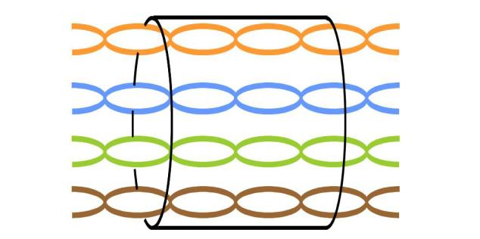
Laying the Groundwork
Category 3 Systems
Capable of 10Base-T or 10 Mbps(Mega Bits Per Second)
Utilized typical 4 pair cabling
Only 2 pairs were utilized - 1 pair to transmit, 1 pair to receive
SWITCH
Tx
Rx
NIC CARD (PC)
Rx
Tx
Notes:
To connect two switches or two NIC cards, cross over patch cords were utilized because you had to flip the pairs in order for them to communicate.

Slide 4
Laying the Groundwork
Category 3 Systems
Key Parameters
Parameter | Cat 3 | Cat 5 | TSB95 | Cat 5e | Cat 6 | Cat 6A
NEXT
Attenuation
ACR
PSNEXT
ELFEXT
PSELFEXT
Return Loss
Notes:
Pair to Pair NEXT loss is a measure of signal coupling from one pair to another.

Slide 5
Laying the Groundwork
Near End CrossTalk (NEXT) (dB)
Tx
Rx
Rx
Tx
Notes:
Pair to Pair NEXT loss is a measure of signal coupling from one pair
to another.

Slide 6
Laying the Groundwork
Category 3 Systems
Key Parameters
Parameter | Cat 3 | Cat 5 | TSB95 | Cat 5e | Cat 6 | Cat 6A
NEXT
Attenuation
ACR
PSNEXT
ELFEXT
PSELFEXT
Return Loss

Slide 7
Laying the Groundwork
Attenuation (dB)
Tx
Rx
Rx
Tx
Notes:
Attenuation is the propagation of waves and signals in the cabling. Attenuation is measured by a power ratio – you want to have enough signal to get from one end to the other, but not so much signal that it increases the noise measured as NEXT.

Slide 8
Laying the Groundwork
Category 3 Systems
Key Parameters
Parameter | Cat 3 | Cat 5 | TSB95 | Cat 5e | Cat 6 | Cat 6A
NEXT
Attenuation
ACR
PSNEXT
ELFEXT
PSELFEXT
Return Loss

Slide 9
Laying the Groundwork
ACR (dB)
Tx
Rx
Rx
Tx
Notes:
ACR is another way to state signal to noise ratio – you want to have enough signal to get from one end to the other but not too much signal that it increases the noise measured through NEXT – Near End Cross Talk. You always want to make sure that your signal is greater than your noise or your attenuation and cross talk are minimized. This measurement is called Headroom – how much more signal you have than cross talk.

Slide 10
Laying the Groundwork
Category 5
IEEE wanted 10X more throughput (Mbps) over the same 4 pair cabling system….only over a 100 MHz system
Key Parameters included:
Parameter | Cat 3 | Cat 5 | TSB95 | Cat 5e | Cat 6 | Cat 6A
NEXT
Attenuation
ACR
PSNEXT
ELFEXT
PSELFEXT
Return Loss

Slide 11
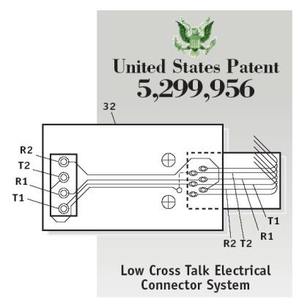
Laying the Groundwork
Category 5
OCC’s Patented Technology
Compensation techniques for tuning of a PC Board to obtain higher bit rates from traditional 4 Pair Cabling
Because of the PC Board tuning developed by OCC, the industry was able to reach the Category 5 standard or a 100BASE-T or 100 Mbps system (aka Fast Ethernet)
OCC was the first to make a Category 5 connector
Notes:
OCC holds many patents. The one most known in our industry is reducing crosstalk on a PC board which is applicable for Cat 5E & Cat 6 connectivity.
This invention revolutionized the high-speed connector industry which forms the basis for crosstalk reduction and is still required today.
OCC holds over 19 active patents, 32 active foreign patents, cross- licensed to another 50+, and has over 28 licensee’s
Plugs have a lot of crosstalk (noise) and our patent cancels that noise with an opposite noise – like noise cancelling headphones.

Slide 12
Laying the Groundwork
Category 5
IEEE wants 10X more throughput 1000BASE-T or 1000 Mbps
IEEE wants to achieve this over the installed base of Category 5 cabling
IEEE asks TIA to further define Category 5 cabling systems to accommodate full bi-directional transmissions
SWITCH
Tx/Rx
Tx/Rx
NIC CARD (PC)
Tx/Rx
Tx/Rx
Tx/Rx
Tx/Rx
Tx/Rx
Tx/Rx
Notes:
1000BASE-T systems were able to transmit and receive on the same pair. Utilizing bi-directional transmission created new variables.

Slide 13
Laying the Groundwork
Power Sum Near End CrossTalk (PSNEXT) (dB)
Tx/Rx
Tx/Rx
Tx/Rx
Tx/Rx
Tx/Rx
Tx/Rx
Tx/Rx
Tx/Rx
Notes:
With bi-directional transmission, not only do you have to worry about one transmitter bleeding signal on to the adjacent receiver. You also have to take in to account that there are 2 other transmitters that can bleed signal to that receiver. Now you have three sources of noise. The sum of that noise is referred to as Power Sum or Power Sum Near End Cross Talk (PSNEXT)

Slide 14
Laying the Groundwork
TSB95
IEEE’s further definition of Category 5
Key Parameters included:
Parameter | Cat 3 | Cat 5 | TSB95 | Cat 5e | Cat 6 | Cat 6A
NEXT
Attenuation
ACR
PSNEXT
ELFEXT
PSELFEXT
Return Loss
Notes:
PSNEXT was issued back to IEEE as TSB95 and was one of the first obstacles to furthering Category 5 cabling.

Slide 15
Laying the Groundwork
Equal Level Far End Cross Talk (ELFEXT) (dB)
Tx/Rx
Tx/Rx
Tx/Rx
Tx/Rx
Tx/Rx
Tx/Rx
Tx/Rx
Tx/Rx
Notes:
Now with bi-directional transmission, you also had 3 more receivers. You now needed to measure the cross talk at the receiver level which is called Far End Cross Talk or FEXT. Far End Cross Talk is that bleed over to the adjacent pair that is going to get picked up at the receiving end. When you do channel testing, when you measure at the receiving end you have one key variable, power. If you take the measure at the receiving end, Power can be a higher or lower power based on the length of the run. For instance, a 25 meter run will require lower power because of lower attenuation but a 100 meter run will require more power because there is more attenuation. Because of that, the measurement takes into account the attenuation of the receive pair and subtracts it out. This was called Equal Level Far End Cross Talk or ELFEXT. Since the introduction of 568-C.2, this has now been changed to Attenuation Crosstalk Ratio, Far-end, or ACRF

Slide 16
Laying the Groundwork
TSB95
IEEE’s further definition of Category 5
Key Parameters included:
Parameter | Cat 3 | Cat 5 | TSB95 | Cat 5e | Cat 6 | Cat 6A
NEXT
Attenuation
ACR
PSNEXT
ELFEXT
PSELFEXT
Return Loss

Slide 17
Laying the Groundwork
Equal Level Far End Cross Talk (ELFEXT) (dB)
Tx/Rx
Tx/Rx
Tx/Rx
Tx/Rx
Tx/Rx
Tx/Rx
Tx/Rx
Tx/Rx
Notes:
Now just like you can measure Power Sum Near End Cross Talk, with bi-directional transmissions, you needed to measure the Power Sum Far End Cross Talk or the sum of the noise of 3 transmitters at the receiver end.

Slide 18
Laying the Groundwork
TSB95
IEEE’s further definition of Category 5
Key Parameters included:
Parameter | Cat 3 | Cat 5 | TSB95 | Cat 5e | Cat 6 | Cat 6A
NEXT
Attenuation
ACR
PSNEXT
ELFEXT
PSELFEXT
Return Loss

Slide 19
Laying the Groundwork
Return Loss (RL) (dB)
Tx/Rx
Tx/Rx
Tx/Rx
Tx/Rx
Tx/Rx
Tx/Rx
Tx/Rx
Tx/Rx
Notes:
Previously you only had one transmitter and one receiver within a 2-pair format. Now you have a transmitter and receiver at both ends of each pair. So when you transmit a signal and you get an echo back of that signal. Return Loss is the measurement of how much of that signal is being bounced back to the transmitter.

Slide 20
Laying the Groundwork
TSB95
IEEE’s further definition of Category 5
Key Parameters included:
Parameter | Cat 3 | Cat 5 | TSB95 | Cat 5e | Cat 6 | Cat 6A
NEXT
Attenuation
ACR
PSNEXT
ELFEXT
PSELFEXT
Return Loss
Notes:
TSB95 was just a further definition of Cat 5 – 100MHz systems now running 1000 Mbps.

Slide 21
Laying the Groundwork
TSB95 to Category 5e
TIA took all the TSB95’s parameters and cleaned it up into one standard - Category 5e
Key Parameters included:
Parameter | Cat 3 | Cat 5 | TSB95 | Cat 5e | Cat 6 | Cat 6A
NEXT
Attenuation
ACR
PSNEXT
ELFEXT
PSELFEXT
Return Loss
Notes:
The TIA standard utilized the same product, same systems, same intent, and same protocols as the TSB95 but just raised the bar on the electrical and called it Category 5e. For instance on Category 5 systems the NEXT allowed measurement was 40dB but on Category 5e it was 43dB.

Slide 22
Laying the Groundwork
Category 6
Same testing parameters as Category 5e just at 250 MHz
To ensure interoperability, OCC came out with the Pyramid Adapter – a test fixture that measures and qualifies test plugs to Category standards
Parameter | Cat 3 | Cat 5 | TSB95 | Cat 5e | Cat 6 | Cat 6A
NEXT
Attenuation
ACR
PSNEXT
ELFEXT
PSELFEXT
Return Loss
Notes:
The Category 6 system was not made for any particular protocol. Many people believed that Category 6 would be the next Category 4, absent from the chart above because it was a cabling system that didn’t last very long, no one really wanted it and it had no particular protocol. It never caught on and Category 5 came along and took it over. At the initial TIA development of the Category 6 systems, Sterling Vaden (VP of R&D & Engineering) proposed that there was no interoperability with the Cat 6 standard – no way to control the test plugs or to accurately measure the components for component compliance. Therefore, Cat 6 systems would be totally proprietary among manufacturers. A jack is dependant on the other connectors from that manufacturer because of how the system would have been designed. He pointed out that standards were meant to ensure interoperability among manufacturers. The reason they were not interoperable is because there was no reliable test fixture to interface connectors at that frequency.

Slide 23
Designing to the Standard
The Pyramid Test Adapter qualifies test plugs that are within a range of Standard compliance
In order to be compliant with the standard, the connector must be compliant with every test plug and to the parameters of the standard established by the Pyramid Adapter.
The Pyramid Adapter helped ensure the value of each test plug and to give every manufacturer a consistent value to design their systems to one common piece – which is the Pyramid Adapter
Notes:
Throughout the industry every manufacturer should be referred back to the Pyramid Adapter because they are designing their systems to test plugs controlled by the OCC Pyramid Adapter. When OCC designs their systems, we design to the center of the range of test plugs so that we work with the entire range of plugs.

Slide 24
Designing to the Standard
Within this range of test plugs, OCC designs our systems to the center of the range. While many manufacturers will be tuned to either the high end or the low end

Slide 25
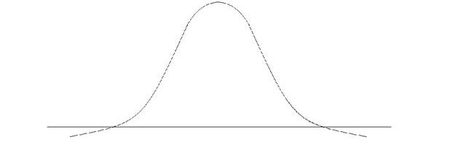
Designing to the Standard
If you are tuned to the high end, then typically you will not be compliant with the lower end.
If you are tuned to the low end , then typically you will not be compliant with the higher end.
Only by tuning to the center, can you ensure that your system can operate within the full range and guarantee interoperability and standards compliance
Notes:
Our connectors are tuned right down the middle and the groundwork information has been reviewed on all of this because you need to understand 2 parameters – FEXT (Far End Cross Talk) and RL (Return Loss). These 2 parameters are key to the way we design OCC connectivity components.

Slide 26
OCC’s Design & Manufacture Process
OCC is the only manufacturer that designs to the Patch Cord Test Adapter Standard (written into and above the Category 5e, 6 and 6A standards)
Requirements for being compliant with the Patch Cord Test Adapter Standard include:
Being tuned to the center of the test plug operating range
Elevated headroom to FEXT and RL parameters.
OCC is the only company who meets these requirements
Notes:
We call this designing to the Patch Cord Test Adapter standard (reaches above the Category 5e, 6, and 6A standard and is mentioned within the standard itself). In order to test patch cords, Fluke uses our adapters with their testers for patch cord manufacturers.

Slide 27
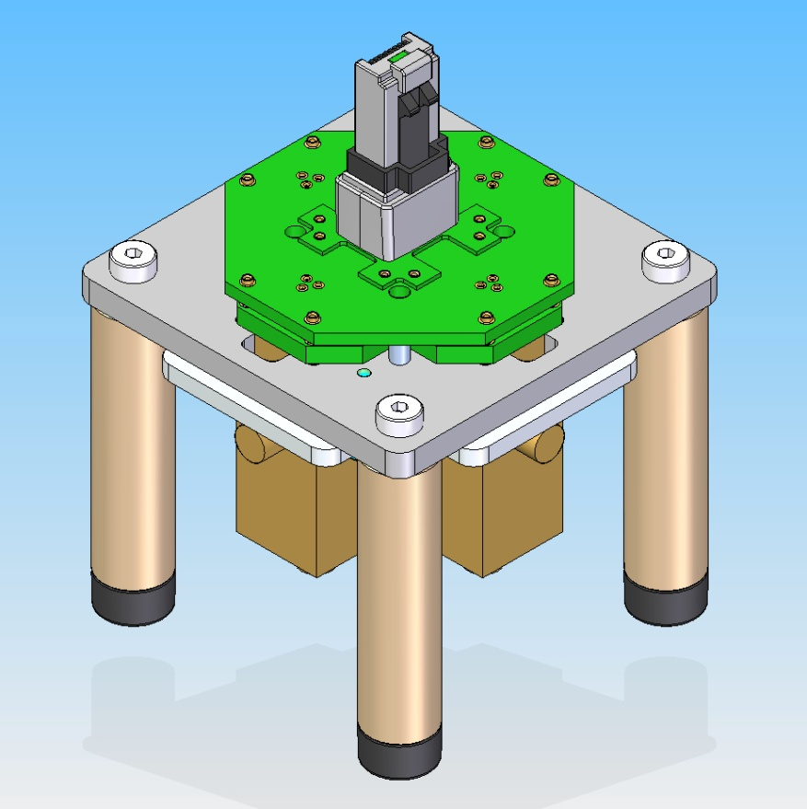
The New Fixture – The New Standard
OCC’s newest test fixtures enabled the accurate measurement of Category 6A cables and hardware in 568-B.2-10
TIA-568-C.2 consolidates all previous standards for Categories 5e, 6, and 6A
The greatest change within the standard is the ability to test all Categories, not just 6A, using one test method - And one Test Fixture!
The Pyramid Adapter is replaced by the OCC 6A Test Fixture
Notes:
Because of the higher frequencies of Category 6A (up to 500 MHz), it became apparent that the limitations of the Pyramid Adapter had been reached. OCC took on the challenge and invented a new fixture that could meet the demands. It was a huge success, and when the time came to create the ‘568-C.2 document, the industry voted to qualify all categories of the connecting hardware and cables using these new fixtures and associated test methods.

Slide 28
Laying the Groundwork
Category 6A
Same testing parameters as Category 6 just at 500 MHz
Parameter | Cat 3 | Cat 5 | TSB95 | Cat 5e | Cat 6 | Cat 6A
NEXT
Attenuation
ACR
PSNEXT
ELFEXT
PSELFEXT
Return Loss

Slide 29
Category 5e, 6 and 6A Design/Manufacture Model
The 6A Test Fixture represents the written standards by TIA
The 6A Test Fixture qualifies the test plugs used to determine component compliance
The Test Plugs are what are used to qualify connectivity as to whether they are component compliant. In the case of OCC, our connectivity is also Patch Cord Test Adapters.
Because OCC connectivity is also PCTA, our connectors also qualify our Patch Cords
And because of patents within our patch cord plug design, our patch cords can also act as test plugs
6A Test Fixture
Test Plugs
Connectivity / PCTA
Patch Cords
Notes:
OCC has a patent on the plug used for our Category 6 patch cord. The plug patent is going to be found in both our patch cords and the test plugs used to qualify components to the standard.

Slide 30
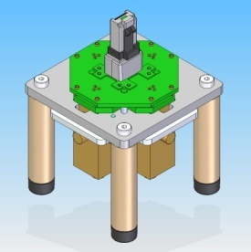
Category 5e, 6, and 6A Design/Manufacture Model
By following this, OCC has created a closed loop model within our design and manufacture process that references right back to the standards.
6A Test Fixture
Test Plugs
Connectivity / PCTA
Patch Cords
Notes:
**And remember, this technology for testing 6A is the same technology we use to test 5e and 6. If we put this much effort into testing just our 5e products, imagine the effort that went into the designing the product itself!**

Slide 31
OCC’s Design & Manufacture Model
To Review:
Technology was implemented through the progression of the different Category levels including the patents that OCC developed.
The technology is what gave us the standards development
The standards are what pushed OCC to develop the Pyramid Adapter/6A Test Fixture and the Patch Cord Test Adapter Standards
And it is to these Standards that OCC uses the Design and Manufacture model on our products day to day
OCC is the only manufacturer that designs to this model .

Slide 32
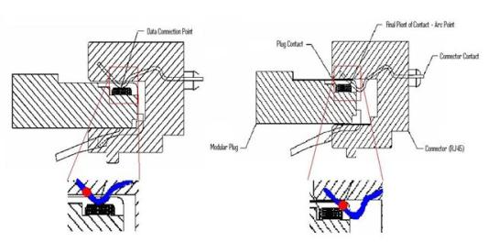
OCC’s Design & Manufacture Model
So how does this benefit the customer?
Quality/Durability
# of Insertions above standard
Contact Resistance
Power Safety Pins
Notes:
Standard requires a connector to withstand 750 insertions and withdrawals to be standards compliant; because our connector was intended to be used in test labs as a Patch Cord Test Adapter, OCC’s connectors have been tested to over 10,000 insertions without any degradation.
A typical jack’s contact force, which ensures good mating of the connector and plug, after so many insertions will begin to wear down. Because OCC’s connectors were designed to withstand so many more insertions, the contacts were designed to allow for better contact force.
Power safety pins, related to Power over Ethernet, are designed into every OCC jack creating a safe place for the natural arc of electricity that occurs when plugs are inserted and removed from the jack.

Slide 33
OCC’s Design & Manufacture Model
So how does this benefit the customer?
Performance
Interoperability
Benefits to Distributors and Contractors for stocking the best product for day to day business
Shorter Lengths
Typical ETL/UL data from competitors (90 meters for link and 100 meters for channel) are all the same
As the lengths get shorter, OCC’s test data is going to be well ahead because we have center-tuned our connectors
Process and Change Controls
Consistency in Quality
USA made
Notes:
All of our connectors are designed dead center of the standards range (test plug range) and because of that are considered compliant to the Patch Cord Test Adapter standard. Because of this, our connectors are interoperable meaning that they will not degrade and are highly likely to improve the system performance.
From a financial standpoint, if you are looking to stock or provide the best product you can that will increase the performance of any system, you should stock the OCC product. There is no better product to have on hand for day to day business that will ensure performance than OCC’s.
The Design and Manufacture model allows OCC to control the processes and development used to manufacture our products. And because we manufacture to a standard, our products are always consistent. In addition, because we have those processes in place, you get the benefit of a USA made product – which can help with ARRA and Buy America initiatives that have been put in place domestically.

Slide 34
OCC’s Design & Manufacture Model
OCC’s Test & Measurement Grade Quality – What does this mean?
Product Grades | Competitors/Major Players
Residential Grade | Pass & Seymour, Leviton, Dynacom, ICC
Contractor (Builders) Grade | Tech Choice by Ortronics, Netkey by Panduit, Leviton, Hubbell, ICC
Commercial/Spec Grade | Systimax/ Commscope, Ortronics, Panduit, Siemon, ADC
Industrial Grade (Specialized) | Woodhead, Siemon, AIS division
Test & Measurement Grade | OCC
Test & Measurement Grade is precision, very high-controlled processes that produce products that are as near perfection to the standard as possible.
OCC is the only manufacturer that offers Test & Measurement Grade products!
Notes:
All these benefits to the customer speak to the Test and Measurement Quality of OCC’s product.
Test & Measurement Grade is

Slide 35
QUESTIONS?

