Slide 1

Presentation Title Goes Here
OCC Harsh Environment Products

Slide 2




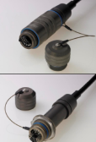





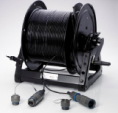


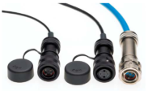

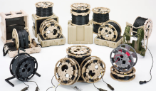


M83522 “ST” Connectors Adapters and Accessories
RJ-45 Rugged
M29504 Qualified Termini
TFOCA Adapters & Adapter Cables
Pierside /Tactical Hermaphroditics
Fanout Assemblies
M28876 Assemblies
Tactical Deployable Breakouts Boxes
Self Releasing Connectors
TFOCA BI-CONIC Connectors and Assemblies
D38999 Assemblies
Standard Commercial Reels
COTS-83526 -TFOCA 4, 6, 12, 24 Channel
EZ-MATE TM Enhanced Endface Hermaphroditic
HPCTM Laser Terminations
Backpack Reels
F-LINK TM Electrical / Optical Family
Self Closing Dust Covers
Cleaning and Refurbishment Kits
Enhanced Tactical Reel Sys.

Slide 3
ST Connectors
“Single Terminus”
All connectors are plugs and mate using an ST adapter
U.S. Military Specification version
Extreme explosive shock and vibration applications
COTS -Commercial equivalents versions
Reliable harsh environments moderate vibration

Slide 4
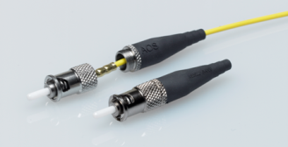
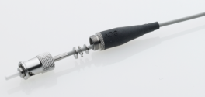
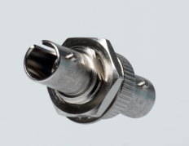
MIL ST and Adapters
MIL-C-83522 “ST Connectors and ST Adapters
  MIL Qualified Product – All Versions
  -ANX, -ANY, -DNX, -DNY available in stainless steel or nickel plated brass.
  High quality commercial versions (COTS) with reduced spring force also available and widely used. Closed entry versus lesser commercial with open entry.
M83522/16-DNX
M83522/16-ANX
M83522/17-NY

Slide 5
M29504/14 /15 Terminus
Used in:
Shipboard connectors
Pierside connectors
Higher Density Tactical Connectors

Slide 6
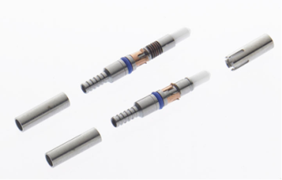
M29504/14 & M29504/15 Termini
MIL SPEC QUALIFIED
    Navy Applications use these for M28876 Connectors
    Used in Tactical “Pierside” Connectors (Navy & Army)
    Used in AIS Tactical COTS-83526 Connectors
    Typical sales are through distributors for mil connector products, or OEM cable assembly shops and for assemblies we manufacture.

Slide 7
M28876 Cable Assemblies
Connector of choice for Navy Shipboard (surface and submarine)
Uses M29504 terminus
High Shock Capable
Used in other deployed non-tactical applications
OCC does not manufacture the connector, we manufacture completed assemblies, using our own terminus

Slide 8
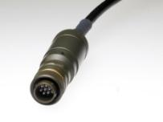
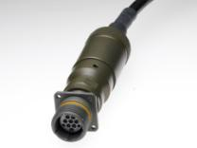
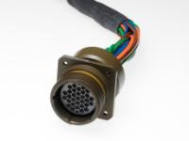
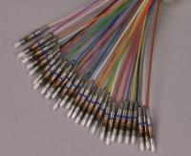
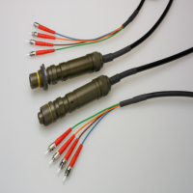
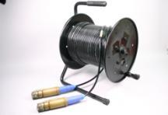
M28876 –Shipboard Assemblies
MIL-PRF-28876 4 , 8 , 18, 31 Channel Fiber Optic Assemblies
Currently we purchase these connectors on open market
They are available from several QPL sources: Delphi, AFSI, Stran.

Slide 9
TFOCA & COTS-83526
Applications include:
Military Tactical Communications
Defense Mobility
Rapid Deployment
Reliable
Disaster Recovery
Mining
Oil & Gas
Deployable Broadcast
Generally, very hostile, rough handling, severe environments.

Slide 10
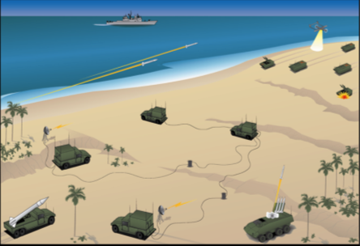

Typical Applications for Military
Radio Repeaters & Terminals
Tactical Multiplexers & Switches
TACC Shelters – Tactical Operations Shelters

Slide 11
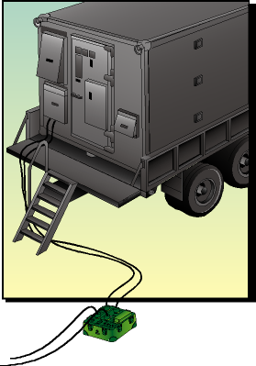
Fiber Optic Modems
May be mounted in-line or inside or on vehicles
CX11230
CX11230
Fiber Optic
Fiber Optic

Slide 12
“TFOCA” Refers to the original 2 Channel, Biconic, Tactical Fiber Optic Cable Assembly developed by AT&T. There is no trademark or patent on TFOCA
“TFOCA-IITM “ refers to the second generation of this product, developed at Fiber Systems. 3 of 4 original patent holders are at OCC-Dallas.
OCC-Dallas manufactures BOTH of these product families.
The TM is registered to AFSI and owns the original patent.
Our product does not infringe on any AFSI patent
There currently is no released specification for the TFOCA-II
A specification was written under Mil-PRF-83526/16 and /17 but was retracted during the patent litigation period. It has not been re-released.
We sell our product as COTS-83526 and our product met the requirements of the specification as previously spelled out
A few points about TFOCA Terminology

Slide 13
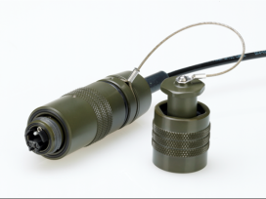
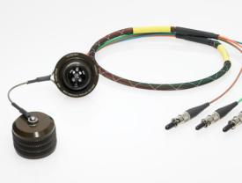
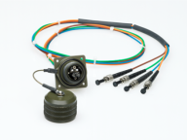
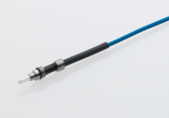
COTS-MIL-PRF-83526 - 4 CH Version
  Connectors & Assemblies
    4 CH Product Family Complete
    (Plug, Jam-nut, Flange Mount Receptacle, and Termini)
    Designed to MIL-PRF-83526/16, /17 and MIL-PRF-29504/16 standards
    Fully inter-operable, inter-mateable, inter-changeable with TFOCA-II®
    Plug and Receptacles work perfectly with TFOCA-II®
    Captive Split Alignment Sleeves

Slide 14
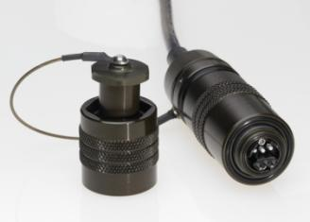
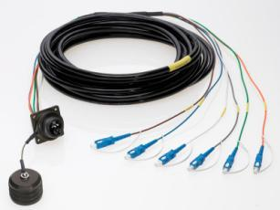
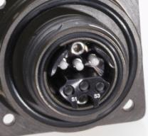
COTS-MIL-PRF-83526 - 6 CH Version
CONNECTORS & ASSEMBLIES
    New 6 CH version of COTS M83526/16, /17, /18
    Utilize M29504/14 Pin only (Genderless termini)
    Same product attributes as 4 CH COTS M83526
    Captive Alignment Sleeve

Slide 15
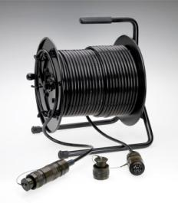
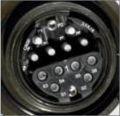
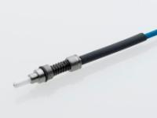
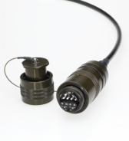
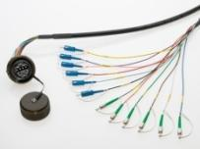
COTS-MIL-PRF-83526 – 12 & 24 Channel Versions
  CONNECTORS AND ASSEMBLIES
    12 CH version of COTS M83526 complete
    12 CH Fully inter-operable, inter-mateable, inter-changeable with TFOCA-II®
    Captive Split Alignment Sleeves

Slide 16
EZ-MATE^{TM -} A commercial TFOCA Variant
Utilized the proven TFOCA system
Developed as a commercial version that was unique & not involved in patent issues
Enhanced, simplified end face for ease of mating

Slide 17
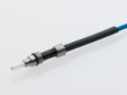
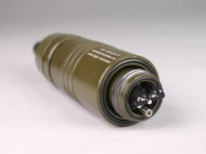
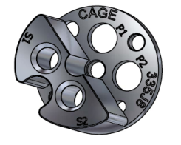
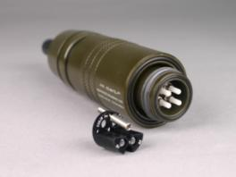
EZ-MATETM
  EZ-MATETM Enhanced end face:
    Newly designed interface cap for tactical COTS-83526
    Eases alignment of two connector faces when mating
  Does not inter-mate with current fielded product
  BUT- Cap can be installed on current fielded TFOCA-II product in field, and thus allows Inter-mating with new EZ-MATETM
    4, 6, 12, 24 Channel version designs complete

Slide 18
PIERSIDE CONNECTORS
Originally designed for U.S. Navy ships docked at piers.
Now used in mining, broadcast, military tactical, seismic applications including U.S. Army.
Hermaphroditic Connectors
Removable end cap for cleaning inspection
SM/MM
Mil-Spec termini used

Slide 19
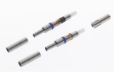
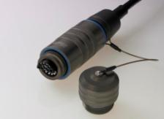
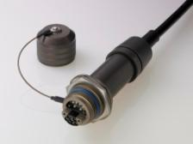
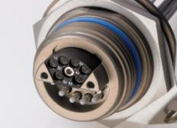
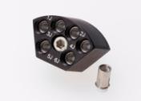
6 or 12 CH Hermaphroditic (“Pierside”)
Designed IAW NAVSEA 7379171 & 7379172 DRAWINGS
Utilize MIL-T-29504/14 Pin termini, MIL-T-29504/15 Sockets (w/o guide bushings)
Complete inter-changeability, inter-operability with Delphi Pierside products
OCC product features include:
  PLUG accommodates “D” or “B” Series cable
  (6.5mm, 11mmm, 14 mm diameters)
  JAM NUT Receptacle without backshell or with
  Integrated Backshell for Jam Nut Receptacle
  Detachable Socket Insert (DSI) (aka “WEDGE”)
  Replacement Captivator Guide Bushings

Slide 20
Pier Connection Application
Customer needed to connect to ships that were docking on port.
                Complete inter-changeability, inter-operability with available pierside products.
Connector requirements for this application:
  Insert must be removable for easy cleaning.
  Must employ SM and MM termini.
  Survive 24/7 exposure in salt air, fuel and other pier side contaminants.
  Cable and connector must survive being run over by pierside vehicles and abused on the piers when installed or retracted back on reels.
  Must be able to concatenate assemblies so a single length of cable can be used for longer lengths while maintaining single stock item.

Slide 21
Mini-Hermaphroditic MHC
Robotic systems
Broadcast
Light weight tactical applications

Slide 22
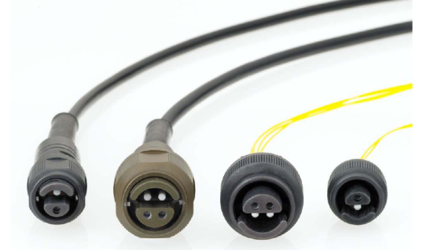
Mini-Hermaphroditic
2 or 4 Channel count (more channels in development)
Single Mode or Multi-Mode
Verification of design for Singlemode and Multimode complete April 2010

Slide 23
REELS
OCC-Dallas Designed and Manufacturing
Tactical
Oil & Gas
Broadcast
Test Sites
Disaster Recovery Teams
We also utilize other manufacturer’s customer specified reels

Slide 24
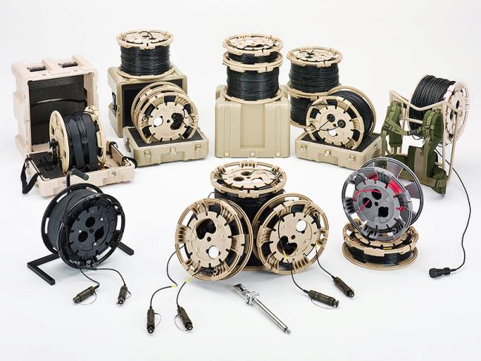
OCC-Dallas REELS

Slide 25
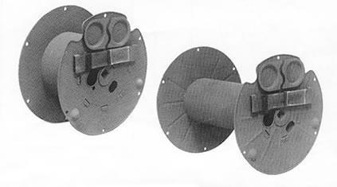
Current Mil-TAC Reels
PROBLEMS:
Sole sourced, unresponsive vendor
Lack of upgrades to very old design
Expensive for the value provided
Non-user friendly mounting and deployment /retrieval process
Photo from Shane Industries

Slide 26
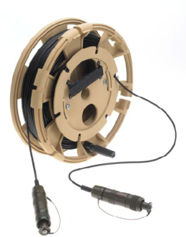
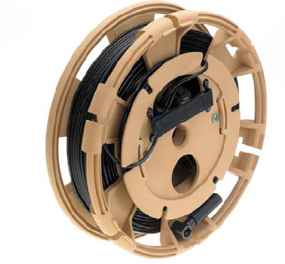
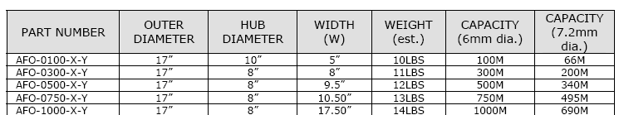
OCC-Dallas REELS

Slide 27
Summary OCC-Dallas REELS
AOS Reeling System | Current Tactical Reels
Folding handle for re-spooling | No handle provided
Non corroding high impact composite material (3 color options Green, Desert tan, black, or even custom) | Metal with carc painting. Not very corrosion resistant, tends to rust infield.
Lower weight reeling with integrated divider with 30 foot tether | Higher weight & no handle, 8 foot external wind tether
Vehicle mount options for re-spooling (2 currently) | None offered. Square drive only for a separate “A-Frame”
Connector storage with Velcro strap | Connector storage with Velcro strap
Storage space for field cleaning kit | No provision
Round bore in drum for axle – Square drive optional | Square drive only option presented
Flanges round with small cable slots | “C” shaped flanges. Will not roll,
Optional transit cases with integral roller mechanism | None offered
Lower weight reel | Higher weight reel
Reel available through Distribution | Build to order, long leadtime

Slide 28
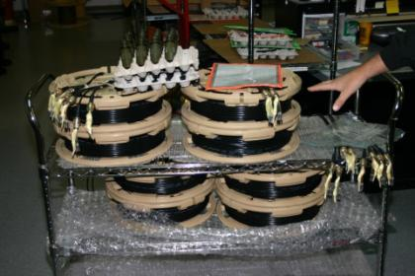
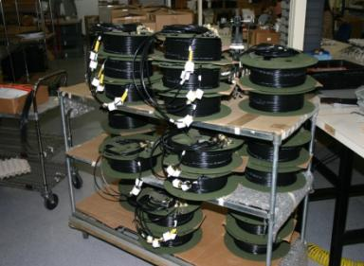
Stackable AFO vs RFO
AFO Stackable with 30 ft divider payout
Built in handle, easy to pick up
RFO difficult to stack with 8ft external windup payout
No handle, difficult to pick up

Slide 29
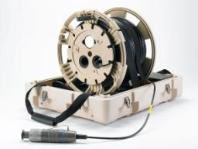
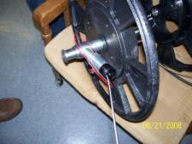
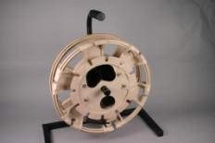
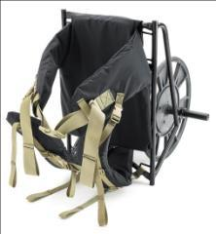
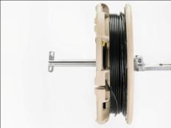
AFO Accessories
Reclaim Systems
  Case/Cradle
  Tri-pod
  Bumper attachment
  Back Pack
  A-Frame
Cleaning kits

Slide 30


OCC-Dallas BACKPACK SYSTEMS
FEATURES & BENEFITS
MODULAR DESIGN BACK PACK INTEGRATES WITH OCC AFO STYLE REEL SYSTEMS
LIGHT WEIGHT CONSTRUCTION BOTH REEL AND BACK PACK FRAME BUILT WITH LIGHT WEIGHT YET DURABLE MATERIALS
SELECTION OF REELS SELECTION OF 100M, 300M OR 500M REEL OPTIONS
SLIP RING OPTION ENABLES UN-INTERRUPTIBLE SIGNAL TRANSMISSION DURING DEPLOYMENT OR ACQUISITION

Slide 31



AFO Reel Mounting System
Vehicle Frame Mount
1) Reel axle retracted and securely attached to vehicle fender bumper guard for transport
2) Axle has been extended to side of vehicle, ready for reel mounting
3) Two AFO-100 (capacity 100 meters of 6.0 mm cable each) reels mounted on reel axle ready for deployment – Can also accommodate AFO-300 and AFO-500 reels

Slide 32
CLEANING KITS
Specific to connector family
Option for reels and transit cases
Sell as stand alone kits also
For all customers saves downtime in field

Slide 33


OCC-Dallas CLEANING KITS
CLEANING KITS
  Originally seen as an accommodation as a result of a service call. Putting these into reels and making them generally available by product family is merely an extension of the overall customer support we want to provide.

Slide 34

Rugged RJ-45 PRODUCT FAMILY
SMALL PROFILE
SEALED (IP67)
NO TOOLS REQUIRED
SHOCK / VIBRATION RESISTANT
EMI PROTECTED
RoHS COMPLIANT
EASY TO REMOVE DUST COVER
OR
OR
FEMALE PLUG
4 – FIBER OPTIC
2 – ELECTRICAL SOCKETS
MALE PLUG
6 – FIBER OPTIC

Slide 35







COMPONENTS, ACCESSORIES
AVAILABLE IN ZiNi, ANODIZE
INCLUDE SEALING GASKETS, O-RINGS
EMC/EMI OPTION ZiNi
PLUG WITH
BACK SHELL
DUST CAP
JAM NUT REC.
IN-LINE RECEPTACLE
WITH BACK SHELL
FLANGE MOUNT
RECEPTACLE
WITH BACK SHELL
DUST CAP
FLANGE MNT REC.
DUST CAP
PLUG
BACK SHELL ONLY
CONDUCTIVE WITH
OVER BRAID CABLE
PROVIDES 360º SHIELDING

Slide 36




Competes with Leading Suppliers of Rugged RJ-45
Amphenol; RJ FIELD, RJFTV Receptacles
  AOS Jam Nut, Flange Mount fit l RJ FIELD cut-out
  R-JACK™ D38999 Jam Nut, Flange Mount Receptacles fit RJF TV cut-out
  R-JACK™ Dust Caps are Smaller
    Designed to allow higher density
    Not compatible with RJ FIELD, RJFTV Dust Caps
RJF TV
R-JACK™

Slide 37

Summary: RJ-45 Electrical Connector

Slide 38
D38999 Fiber Optic “Assemblies”
We build assemblies utilizing the D38999 Connectors
OCC-Dallas does not manufacture the D38999 connectors we procure them from multiple sources
Can accommodate copper and fiber
D-38999 connectors are inexpensive. Termini for these, M29504/4 & /5 are very expensive
Not always the best connector choice for an application, but often specified due to having a Mil-Spec pedigree.

Slide 39








DTL-38999 Connector Assemblies
DTL38999 Connectors originally designed for electrical harnesses
Use M29504/4 & /5 fiber optic termini
Enhanced 38999 Fiber Optic Assemblies – to achieve better performance with same connector series
LUXCIS TERMINI

Slide 40
F-LINKTM
Commercial Harsh Environment Connector System
Fiber Optic or Electrical - or Both (composite)

Slide 41


Why F-LINKTM
Harsh environment, High Density connectors and assemblies
2 to 34 Channels
Fiber or Copper – or any combination in same connector
Utilizes optically proven, ease of termination, genderless, LC sized ferrules
Plug and Receptacles utilize common elements for design simplicity, economies of scale, and versatility in configuration
IP-67: Meet or exceed environmental requirements
Modular – Gender changeable connector design (male to female)
Backshells accommodate cables with or without aramid cable strength members
Singlemode or Multimode optical fiber (or mixed)

Slide 42



F-LINKTM
Why F-LINK?
Versatile Design
  Options for: ● All Optic ● All Electric ● Almost any combination of Optic and Electric
    Optic: Singlemode or Multimode
    Electrical: Up to 16 gage in “standard “cavities
      Can divide larger copper gages and split between multiple 16 gage contacts
      Optionally 10, 12, or 14 gage contacts can be accommodated with modified insert cavities
Fiber Termini Insert
Electrical Pin & Socket

Slide 43

F-LINK™ Product Family
Designed as a cost effective alternative to high cost Military connector systems.
Key “harsh environment” design elements from Military products used, along with innovative cost reduction measures
Harsh Environment is Key:
Excellent connector system for industrial, energy plants, mining, waste water treatment, remote monitoring sites, even campus & school systems

Slide 44
“IRIS” BREAKAWAY
Municipalities
Emergency Equipment Companies

Slide 45

IRIS
Intelligent Release Interconnect System
6 to 12 Channels
Enables connector system to disengage rapidly without damaging fiber.
Designed for traffic control enclosures

Slide 46
Break Away Connector System
Problem:
Traffic pedestals at intersections subject to traffic accident destruction
  Attachment to underground cable plant, results in added damage and need for retrenching and burial of replacement cable feeds to pedestal.
  Very expensive and time consuming, under rapid reaction time requirements, due to safety concerns for traffic

Slide 47

Break Away Connector System

Slide 48



Self Closing Dust Cover
(affectionately: Toilet Seat)
Closed, Mated, Open
Initial application for 12 channel COTS-83526 type connector . Concept can accommodate almost any receptacle connector family

Slide 49
Thank you.
Questions?
www.occfiber.com

