Slide 1
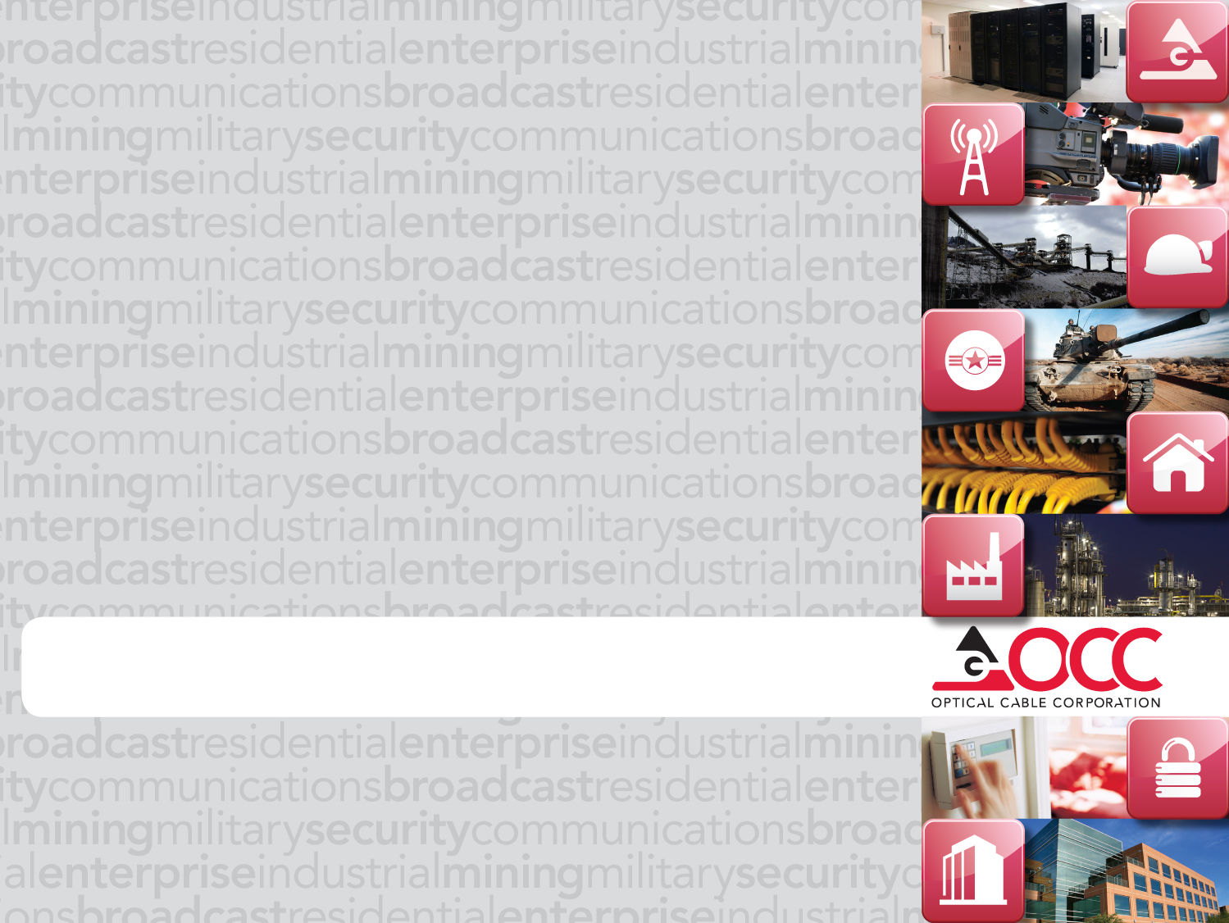
Presentation Title Goes Here
Horizontal and Back Bone Cabling

Slide 2
Horizontal &Backbone Cabling From the Jack Back
Network Architecture Basics
Horizontal cabling (& Where OCC Products fit)
  What is it?
  What is included?
  What standards apply?
  Alternative Configurations
Backbone Cabling (& Where OCC Products fit)
  What is it?
  Types of Backbone cabling

Slide 3
Horizontal & Backbone Cabling
Network Architecture Basics
  4 segments generally divided where one cable ends and another begins
    Horizontal Segment
      Work Area to TR
    Riser Segment
      TR to the ER (one type of Backbone)
    Campus Segment
      Connects multiple Buildings in either an entrance facility or Equipment room (another Backbone)
    Local Access Segment
      The Demarcation point where the network backbone meets the outside world

Slide 4
568-C.1 Commercial Bldg. Cabling System
Notes:
4

Slide 5
Horizontal & Backbone Cabling
Horizontal Cabling
  Begins where a device (Computer, phone, etc.) plug into an outlet.
  That outlet is terminated typically with utp cable which leads back to the TR and is terminated on the back of a patch panel.
  A patch cord is then plugged from the front of the panel into the active equipment that provides access to the end device.

Slide 6
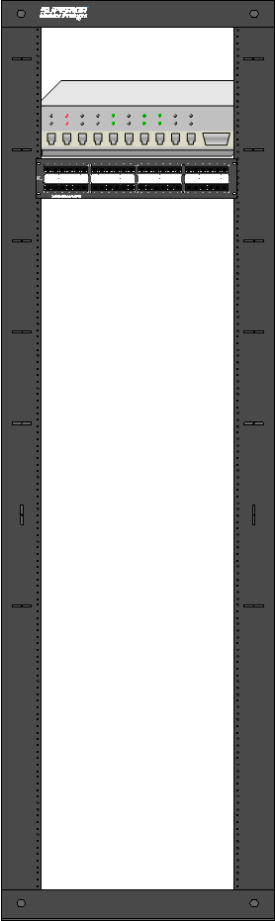
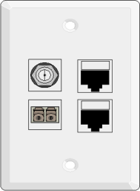
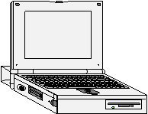
Horizontal Cabling
Patch cord connecting patch panel to active device
Permanent Link: 90 Meter Max
Patch cord connecting device to network
Channel: PL + 10 meters of Patch cords are allowed = 100 meters

Slide 7
Horizontal & Backbone Cabling
Other configurations
  Consolidation Point
    Permanent mid link connection
  Multi User Telecommunication Outlet Assy. (Mutoa)
    Like a CP but not permanent so they can be more easily configured)
    Trade off longer equipment cords for shorter horizontal lengths. (100 meter rule changes depending on patch cord lengths).
  FttE: Fiber to the Enclosure
    Like having a satelite TR
    One way of getting cables out to a WA that is farther than 90M

Slide 8
Horizontal & Backbone Cabling

Slide 9
Horizontal & Backbone Cabling

Slide 10



Horizontal & Backbone Cabling
Still 90 m permanent link
TR
TE
Fiber bypasses TR and extends out to TE. Fiber cable length 300m maximum unspliced recommended by TIA/EIA

Slide 11
Horizontal & Backbone Cabling
What Products are used in the Horizontal segment?
  Patch cords (WA & Closet) (Copper or Fiber)
  Faceplates, surface boxes, multi-media boxes
  Jacks & Adapters
  Cable (Copper or Fiber)
  Patch Panels
  Racks/ Cabinets (floor or Wall)
  Cable Management
  Fiber Boxes

Slide 12
Horizontal & Backbone Cabling
Back Bone Cabling (2 Types)
  The first is Intra-building
    Usually runs between floors through passageways called Risers.
    Can be copper or Fiber
    Can be Distributed or Collapsed
      Distributed Connects to the horizontal cabling (typically in the TR) and is the most flexible for Network Growth
      Collapsed is a direct fiber optic cable link to the WA.
    Intra building backbones are recommended for max runs of 300meters unless high bandwidth fiber is used.

Slide 13
Horizontal & Backbone Cabling
Back Bone Cabling (2 Types)
  The second is Inter-building
    This is the backbone cabling that connects Multiple buildings like you would see in a campus environment
    Due to long distances the preferred cabling choice is fiber optic cable
    Cable can be Aerial, direct buried, or buried in conduit
    Typically one building will house an equipment room where the main cross connect can be found linking all buildings.

Slide 14
568-C.1 Commercial Bldg. Cabling System
Notes:
14

Slide 15
Horizontal & Backbone Cabling
What Products are used in the Backbone segment
  Patch cords (Copper or Fiber)
  Fiber optic Cable
  Patch Panels
  Racks/ Cabinets (floor or Wall)
  Cable Management
  Fiber Boxes
  6 packs
  Fiber closure

Slide 16

STAY CLASSY SAN DIEGO

Slide 17
Quiz
What are the 4 segments of Network Architecture?
What is the point called where the backbone cabling connects with the outside world?
Name 3 OCC products that can be used in the horizontal cabling?
What is the maximum distance of the permanent link?
What product is required to make the permanent link a Channel?
What does FttE stand for?
What are the 2 types of Backbone cabling?
Name 3 OCC products that can be used in the Backbone cabling?
What is the preferred type of cable used as the backbone for campus environments.
A collapsed Backbone uses the horizontal cross connect as a termination point? True or False
Bonus: In What movie Does Will Ferrell say the phrase Stay Classy San Diego?

Slide 18
Answers
Horizontal, Riser, Campus, Local Access
Demarcation Point
Faceplates, Jacks, adapters, cable, Patch panels, patch cords etc.
90meters or 300’
Patch Cords
Fiber to the Enclosure
Intra-building and Inter-building
Fiber cable, fiber boxes, adapters, fiber jumpers, patch cords, patch panels, etc.
Fiber optic Cable, Our Cable, OCC’s cable are all acceptable answers
False
Bonus: Anchor Man: The legend of Ron Burgundy

