Slide 1

MILTAC & QPL Cables and Connectors Offerings
August 2011
Presentation Title Goes Here

Slide 2
Definitions
MILTAC
  Abbreviated form of “military-tactical”
  Designed for battlefield conditions
    Harsh environments (extreme temperatures, humidity, ice, fire, etc.)
    Resistant to damage from cuts, abrasions, crush, impact, chemical exposure, nuclear radiation, etc.
  Includes both qualified and non-qualified cables and connectors
  Also suitable for industrial, mining, petrochemical industries
http://www.occfiber.com/media/library_documents/1236713699_2f_OCC-FOCS_Military.pdf

Slide 3
Definitions
MIL-PRF-85045 (aka “85045”)
  A military general specification for numerous fiber optic cable types
    Ground tactical
    Shipboard
    Others
  Specific cables include both the general specification and specific “slash” sheets which define requirements
    MIL-PRF-85045/8B covers ground tactical cables (2 and 4 channel, 50µm and 62.5µm)
  When someone asks for “85045”, be sure to ask for the slash sheet or full part number

Slide 4

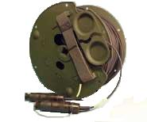
Definitions
CECOM
  U.S. Army Communications-Electronics Command
  Has been OCC’s largest military customer for years
  Purchase “TFOCA” cable assemblies
    TFOCA = Tactical Fiber Optic Cable Assembly”
    TFOCA’s include qualified cable (2 or 4 channel), qualified connectors on a military reel
  CECOM cable specification A3159879
  OCC CECOM qualified cables include:
    OCC part number RK981104-07 (2 channel, 50µm)
    OCC part number RK981104-09 (4 channel, 62.5µm)
  Competitors include Draka and Amphenol
    250µm acrylate coating on their fiber vs. our 500µm coating

Slide 5
Definitions
Qualification
  Means that the cable design has been tested and certified to military specifications (DSCC, CECOM, UK MOD or others)
    Optical Performance
    Mechanical Durability
    Environmental
  The cable design includes qualified components, such as the fiber
  Testing usually done by an independent test lab certified by DSCC
QPL (Qualified Products List)
  Identifies manufacturers and part numbers which have been verified to be compliant with published military specifications

Slide 6
Definitions
DSCC
  Defense Supply Center Columbus (part of Defense Logistics Agency or DLA)
  Recognized authority for establishing military product design and performance requirements
  Reviews product test data for conformance with requirements
  Issues formal certification
  Audits and certifies firms for compliance with MIL-STD-790
    ESTABLISHED RELIABILITY AND HIGH RELIABILITY QUALIFIED PRODUCTS LIST (QPL) SYSTEMS FOR ELECTRICAL, ELECTRONIC, AND FIBER OPTIC PARTS SPECIFICATIONS

Slide 7
QPL Versus Non QPL Ground Tactical
QPL Cables (OC040522-XX)
  OCC has the only cable qualified to MIL-PRF-85045-B8A requirements, OC040522-XX
  QPL fiber is required to be used
  Extensive external testing and approval
  Periodic lot testing based on sales volume
  Periodic requalification – significant cost
  Lead time for fiber, lot testing and minimum order quantities are driven by the QPL fiber and lot testing requirements.
  MOQ – 1km

Slide 8
QPL Versus Non QPL Ground Tactical
RK981104-XX
  Meets CECOM specification A3159879, along with several competitors’ cables
  Tested to the same standard MIL-PRF-85045-B8A (not as extensively as QPL cable)
  Not on QPL (Qualified Product List)
  Not required to use QPL fiber
  Tested by OCC and test report submitted and approved CECOM
  Used by the US Army extensively in assemblies
  We produce this in large quantities for many customer contracts
  More economical to maintain the product line

Slide 9
Bottom Line on QPL versus RK981104
If the request is for the performance of a MIL-PRF-85045-B8A cable – RK981104 could be an acceptable less expensive alternative…but
Always check with Military Business Development folks before offering alternatives – remember, you may be breaking your own spec position!

Slide 10
OCC Qualified Connectors
MIL-STD-83522/16 and /17 connectors (MIL ST’s)
A3159869 Generation 1 TFOCA connectors (2 Channel)
A3302584-X Generation 2 TFOCA connectors (2 and 4 Channel)

Slide 11
What Does It Take To Qualify?
Significant Planning
  Requirements definition (not always clear)
  Evaluate existing designs
  Development of a detailed test plan
    Lists tests, test conditions & and pass / fail criteria
    Usually for approval by certifying agency
  Contract with independent test lab for external testing
    Develop Statement of Work
    Send out requests for quote and evaluate responses
    Develop purchase order and schedule work

Slide 12
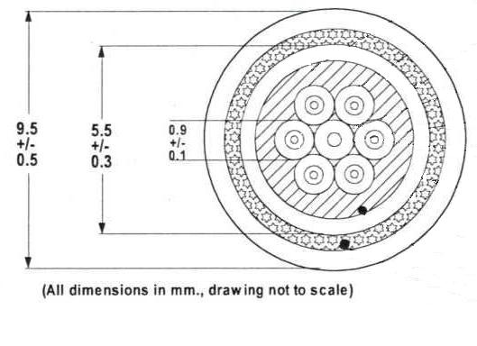
What Does It Take To Qualify?
Development of Detailed Design
  Materials and tooling selection
  Process definition
  Develop design documentation
  Run prototype cables and perform internal confidence testing
  Finalize design

Slide 13
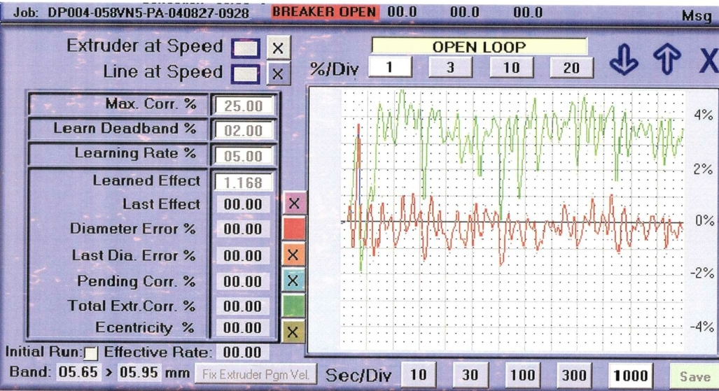
What Does It Take To Qualify?
Produce Test Samples
  Schedule correct amount to ensure adequate cable for all tests
  Monitor production carefully to ensure
    As built configuration matches design
    Process matches design
    Test sample is representative of production cables
      Not “best of best” or marginal
    No defects

Slide 14
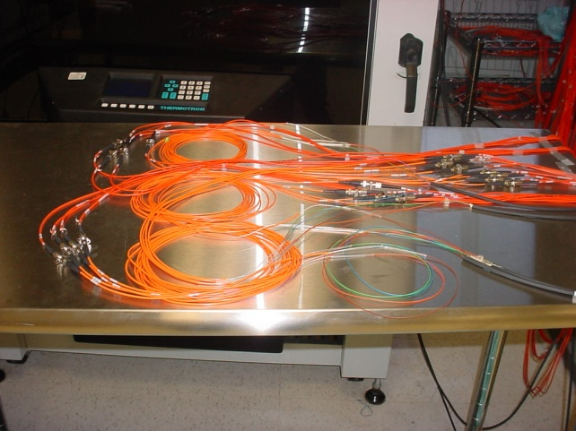
What Does It Take To Qualify?
Management of External Testing
  Evaluation of schedule progress and evaluation / verification of results.
  Investigate non-conformances
    Verify test procedure is correct
    Verify test set-up is correct
    Understand mechanism of non-conformance
    Determine significance of non-conformance
  Detailed review of test report
  Submit test report to Standards & Certification Agency

Slide 15
Example Of Typical Qualification
Planning Schedule

Slide 16
What Does It Take To Qualify?
Dependent on several factors
  Test requirements
  Standards & Certification Agency
  Value of opportunity
  Priority of project & availability of resources
Qualifying an existing design
  ~2-6 months from project start date
  ~$10-30K on average
Qualifying a new design
  ~6-18 months from project start date
  ~$30-60K and up

Slide 17
OCC Qualified Cables and Connectors
A3159879 Ground Tactical Cables (2 and 4 channel)
MIL-DTL-85045/8-B2A, -B4A Two and Four Channel Ground Tactical Cables
DNV Shipboard Deck Cable (OC031016-XX, 2, 4 and 6 channel, MM and SM)
Tray Cables (BX and GX)
UL Cables (multiple)
MSHA cables (multiple)
MIL-STD-83522/16 and /17 connectors (MIL ST’s)
A3159869 Generation 1 TFOCA connectors (2 Channel)
A3302584-X Generation 2 TFOCA connectors (2 and 4 Channel)

Slide 18
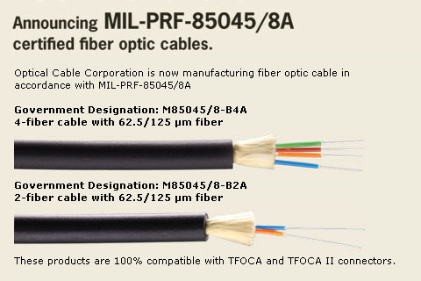
For more information: http://www.occfiber.com

Slide 19
