Slide 1
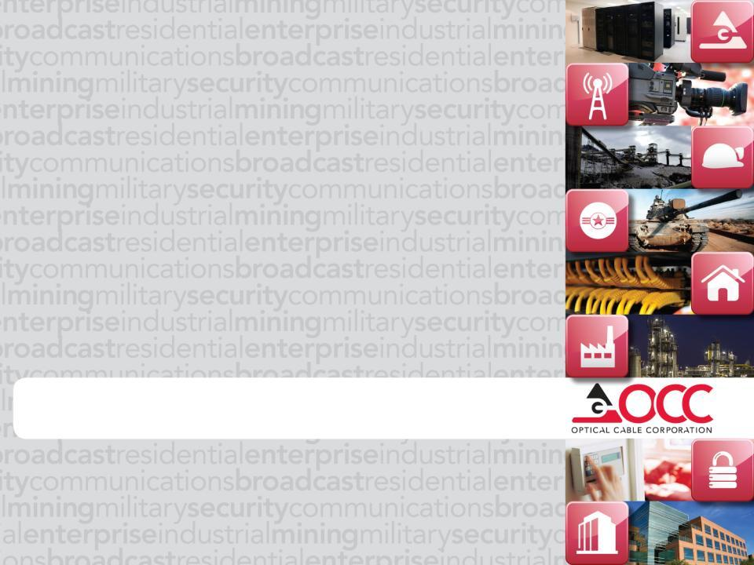
Presentation Title Goes Here
OCC’s 2011 MDIS Program

Slide 2
2011 OCC MDIS Program Agenda
Program Overview and Intent
New Process & Administration
Forms
Existing MDIS vs. New MDIS Certifications
Warranty Submission
MDIS Rebate Program

Slide 3
2011 OCC MDIS Program Overview
Intended for contractors interested in selling, supporting and installing OCC products regularly.
Ideal for establishing true contractor partnerships
Not for one-time warranty projects
Value-added service designed to offer installers technical assistance, specification support and various resources for any application or project using OCC products.

Slide 4
2011 OCC MDIS Program New Processes
Requirements for Consideration Form
Designed to provide a pre-qualification step to become MDIS certified
Requires that the Regional Manager and VP of Sales approves or denies as well – accountability
MUST be completed by OSR – not by Contractor
Certified Installer Agreement
Designed to provide a signed partnership between OCC and the Contractor
Details what our expectations of the Contractor are and what they can expect by being an OCC MDIS Installer

Slide 5
2011 OCC MDIS Program New Processes
Training is provided by factory representative
Improves the sense of value for the OCC MDIS Program
Currently only John Awad, Scott Vandenburg, Michael Stover, and Brad Everette may perform trainings
If none of these are available, Technical Sales will determine who is eligible to perform trainings – OCC Authorized Trainer
Training is modularized
Contractors can choose to be certified in Copper, Fiber or both – prefer that everyone be certified in both.
Training consists of (2) 4 hour modules
Certificates and admin records will denote which option they are certified in.

Slide 6
2011 OCC MDIS Program New Processes
Training offers BICSI Credits
All trainings now offer BICSI RCDD credits – 6 RCDD, Installer, Technician and Certified Trainer credits for certification in both; 2 credits if choose copper or fiber training
Charges for Training
Costs - $250 per module; $500 for both
Covers up to 10 individuals from one Contractor company
Every attendee after 10 from one Contractor company is $25 per module; $40 for both
In return, once the training has been completed, each Contractor company will receive a $250 coupon for each module completed. (Up to $500)
Each coupon has to be redeemed on a single purchase order of $2,500 or more (combined coupons on single purchase orders of $5,000 or more)

Slide 7
2011 OCC MDIS Program New Processes
Redemption of MDIS Coupons
Contractor must redeem MDIS Coupons within 90 days of issuance – OCC Marketing to keep track of issuance and expiration dates
To redeem, Contractor must submit to OCC Marketing their coupon with proofs of purchase including BOM, purchase order and/or copies of paid invoices.
Contractor may purchase products from any OCC distributor
Once all paperwork has been submitted to OCC Marketing, OCC will send monies owed in the form of a check payable to the Contractor company

Slide 8
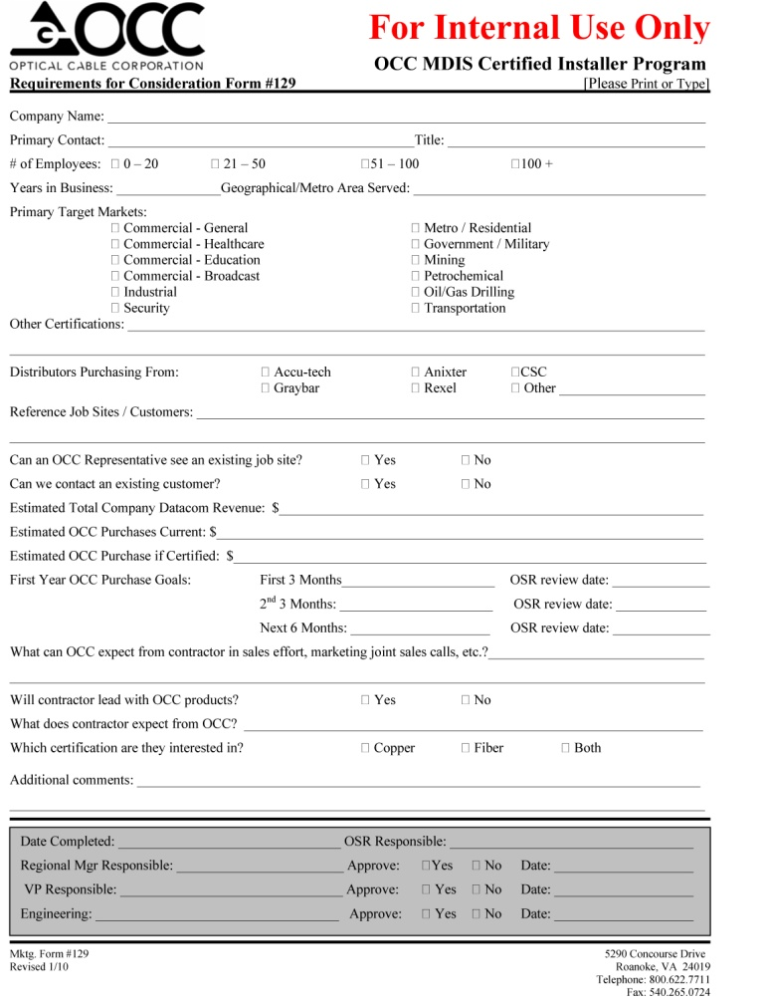
2011 OCC MDIS Program Forms
Request for Consideration Form #129
Must be completed by OSR
Must be completed prior to training

Slide 9
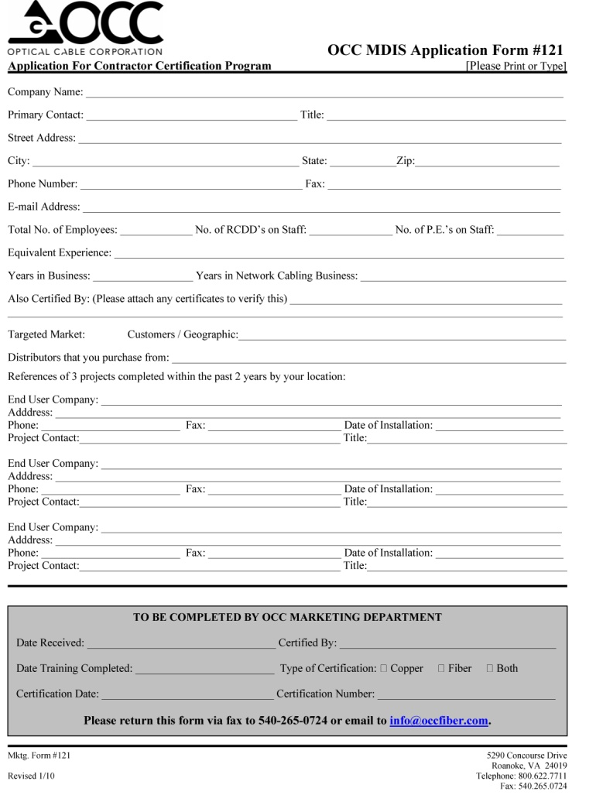
2011 OCC MDIS Program Forms
MDIS Application Form #121
Must be completed by the Contractor Company
Must be completed prior to training
Ensure that information entered is correct including contact information and email address

Slide 10
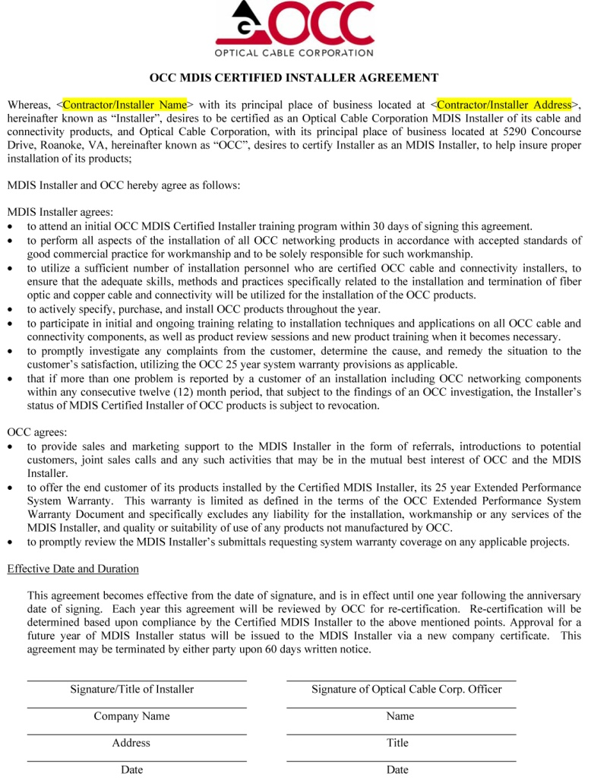
2011 OCC MDIS Program Forms
Certified Installer Agreement
Details OCC’s commitment to the Certified Contractor and OCC’s expectations of that Contractor
Must be signed by Contractor Company prior to training being completed
Once signed by Contractor Company, OCC will sign and send copies

Slide 11
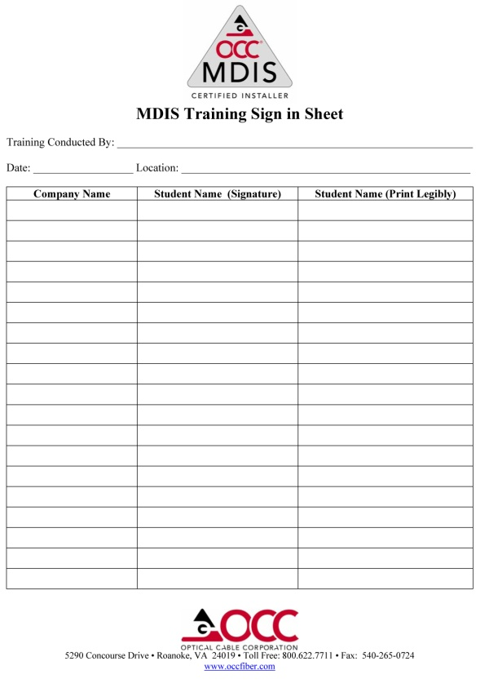
2011 OCC MDIS Program Forms
MDIS Training Day
MDIS Training Sign In Sheet & Manuals

Slide 12
2011 OCC MDIS Program Forms
MDIS Initial Training Certificates with BICSI Credits

Slide 13
2011 OCC MDIS Program
Existing MDIS vs. New MDIS Certifications
Over the last two years, existing MDIS Installers have been reviewed by OSRs, Regional Managers, and VP of Sales
Determination if existing MDIS would be certified in both copper and fiber or just copper or fiber has been completed
Going forward existing MDIS Certifications will continue to need to be recertified every year utilizing the new Recertification Form #122
Re-certification is due on the anniversary date of each MDIS Contractor’s training day
Re-certification reminders will be sent out at the beginning of the month to each OSR detailing those MDIS Contractors who are up for re-certification

Slide 14
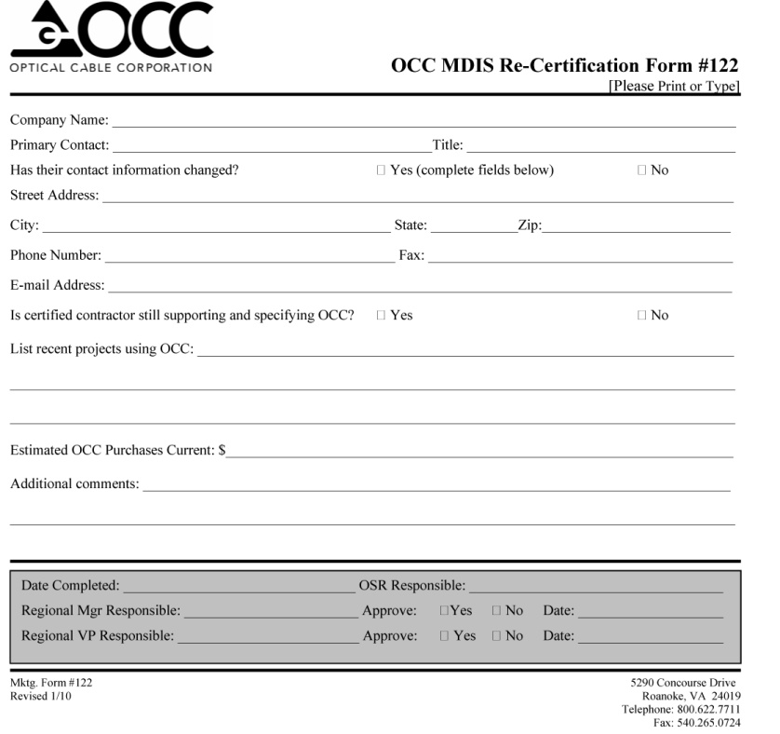
2011 OCC MDIS Program Forms
Recertification Form #122
Must be completed by OSR on every Certified MDIS contractor up for re-certification
Must be approved by Regional Manager and VP of Sales
If decision is made to terminate certification, a termination letter will be sent

Slide 15
2011 OCC MDIS Program
Existing MDIS vs. New MDIS Certifications
Any potential MDIS candidate must be reviewed by the Outside Sales Rep and the Regional Manager.
New MDIS Certifications must go through the entire process.
See flow diagram
Once initial MDIS certification has been issued, re-certification is done yearly from anniversary date of Contractor’s training day
See Re-certification Form #122

Slide 16
Contractor would like to become certified
Contractor contacts ISR who gathers contractor info for OSR
OSR contacts contractor & decides with RM whether to proceed
No, do not sign up
OSR decides not to sign up
OSR Interviews using Req. for Consideration form
Yes, OSR schedules a visit
Does not approve
Yes would like to sign up
Local Sales Rep sends Consideration Form & Application to Reg. Mgr. & RVP for approval
Reg. Mgr. & RVP reviews (runs D&B through Actg.)
Certificates sent to Contractor (Good for 1 Year
Training Scheduled & Completed
Contractor signs Certified Installer Agreement, schedules training & makes payment
Reg. Mgr. & RVP approve
OSR conducts short interview to determine eligibility (runs new D&B)
After 1 yr, re-certification notices sent to OSR, Reg. Mgr. & RVP
Yes, re-certify for another year
New Agreement is sent out to be signed
No, do not re-certify

Slide 17
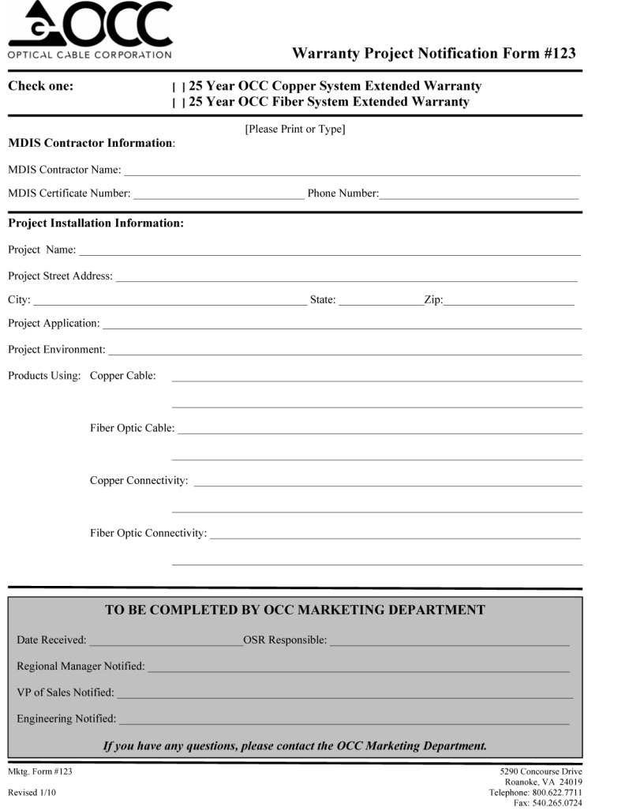
2011 OCC MDIS Warranty Submission
All Existing Certified and New MDIS Contractors may offer their end user a 25 Year Extended System Warranty in copper and/or fiber optic.
When possible, MDIS contractor must submit a Project Notification Form #123 to ensure price protection for the project

Slide 18
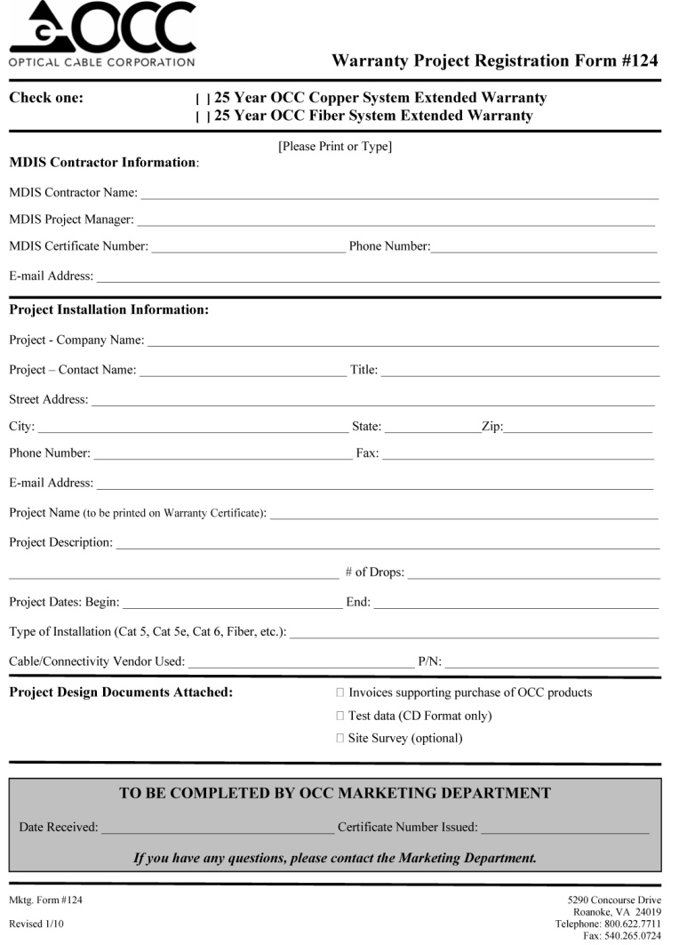
2011 OCC MDIS Warranty Submission
Each Extended Warranty is subject to review and must be submitted with:
Completed Warranty Requirements Checklist
Warranty Registration Form #124
Proofs of Purchase (can include BOM, Purchase Orders, or Paid Invoices)
Test Data – must be in original tester format (no PDF’s) and must test permanent link data

Slide 19
2011 OCC MDIS Warranty Submission
Other Warranty Considerations:
Certified MDIS Contractor must be current and in good standing with OCC
25 Year Extended Warranties are meant specifically for Enterprise and Commercial installations – does not include Harsh Environment cables, Harsh Environment connectivity or installations into non-permanent applications (i.e. mines, military tactical installations, etc.)

Slide 20
2011 OCC MDIS Warranty Submission
Other Warranty Considerations:
OCC seeks to encourage full OCC copper and/or fiber optic structured cabling systems.
OCC will warrant 25 Year Warranty Submissions for copper installations where copper cable from other vendors is utilized
Typical accepted vendors include Mohawk, HCM, Commscope, General Cable, and Berktek
Others may be accepted but must be approved prior to warranty submission – contact OCC Marketing

Slide 21
2011 OCC MDIS Warranty Submission
Other Warranty Considerations:
OCC will not warrant 25 Year Warranty Submissions for fiber optic installations where fiber optic cable from other vendors is utilized
OCC has partnered with other connectivity manufacturers in the past and warranties may be available through the competitive manufacturer utilizing OCC fiber optic cable

Slide 22
2011 OCC MDIS Warranty Submission
Other Warranty Considerations:
OCC continues to offer the 15 Year Product Assurance Warranty on all copper and fiber optic connectivity products
OCC continues to offer a 1 Year Product Assurance Warranty on all copper and fiber optic cable
OCC will no longer publicly offer the 15 Year Extended Fiber Optic Cable Warranty

Slide 23
2011 OCC MDIS Warranty Submission
Prior to issuance of the warranty certificate:
A follow up call will be made by the OCC MDIS Administrator to both the OCC MDIS Contractor responsible and the project’s End User following the issuance of the warranty certificate.
These calls will be to ensure that the installation was successful, performed in a professional manner, products were received in a timely manner, and there was sufficient support from OCC.
Any and all feedback discovered through these calls will be given to the OCC MDIS Contractor, the Outside Sales Rep and the Regional Manager. Once these calls have been completed, a certificate will be issued and recorded in the Warranty Database.

Slide 24
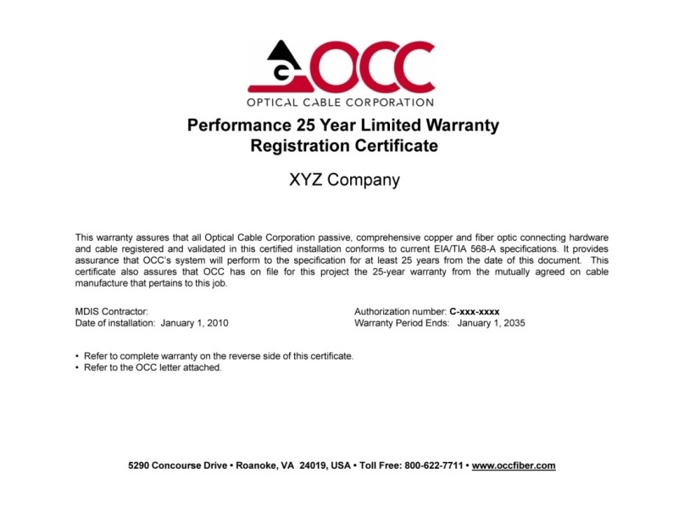
2011 OCC MDIS Warranty Submission
Once the Warranty submission has been approved, a warranty certificate and letter will be issued and sent to the End User with copies sent to the Certified Contractor
OSR and Regional Manager will be notified of warranty submission and approval
Additional copies may be sent to the OSR and Regional Manager upon request

Slide 25
2011 OCC MDIS Rebate Program
Designed to be offered to only those Certified MDIS Installers that are true partners to OCC –
Actively specifying OCC solutions
Purchasing regularly OCC products
Works together with OCC Sales and Marketing team to increase their business
If there is a Certified MDIS Installer that meets these qualifications, contact your Regional Manager to start the process to sign them up.

Slide 26
2011 OCC MDIS Program
Additional Information
All MDIS forms are available on the OCC website under the Sales Support section of the Library/Forms
All questions regarding process and administration can be directed to Gina Knapp, OCC MDIS Administrator
All questions regarding training can be directed to John Awad or Scott Vandenburg - Technical Sales Managers

Slide 27
Any questions?

