Slide 1
Presentation Title Goes Here
Bandwidth vs. Dispersion, or
A Light Refresher of Fiber Optic Terminology

Slide 2
What Does It All Mean? A Light Refresher of FO Terminology
Bandwidth, Dispersion
Microns, Nanometers, Millimeters, Mils
dB, Attenuation
Low Water Peak, Zero Water Peak
Modes, Rays
Core Diameter, Mode Field Diameter
Analog, Digital

Slide 3
Bandwidth and Dispersion
Bandwidth (MBA Jargon): ability to do additional work; generally used to indicate that speaker cannot or would not prefer to do additional work, as in: “I don’t think I’ll have any bandwidth this Friday”
Dispersion (Lingo): “You can’t cast dispersion, but you can cancel it out” (and it’s not nice to cast aspersions either)

Slide 4
Bandwidth of Multimode Fibers
The information carrying capacity of the fiber, bandwidth is the frequency at which the received signal drops to half of its transmitted level (-3dB)
BDP - Bandwidth of a fiber multiplied by the length of the fiber (MHz-Km)
Example: ALE Fiber (50µm 10Gig) BDP of 4700 MHz-km @ 850nm
1 km of the fiber would have a bandwidth of 4700 MHz
2 km of the fiber would have a bandwidth of ≈ 2350 MHz
4 km of the fiber would have a bandwidth of ≈ 1175 MHz
8 km of the fiber would have a bandwidth of ≈ 588 MHz

Slide 5
OCC Laser Bandwidth Comparison

Slide 6
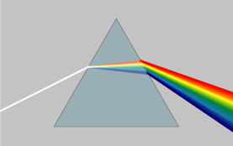
Dispersion in Single-mode Fiber
Dispersion is a measure of the pulse spreading in an optical fiber, limiting information capacity
Single-mode material dispersion happens when different wavelengths propagate at different speeds, even from a single laser

Slide 7
What Causes Dispersion in Single-mode Fiber?
Single-mode dispersion is the result of:
Waveguide dispersion - optical energy travels in both the core & cladding at slightly differ speeds
Material dispersion (predominant factor of single-mode Dispersion) – glass’s index of refraction changes with ג and this causes different ג‘s to travel at different speeds
Zero-Dispersion Wavelength is the wavelength or wavelengths at which the material dispersion and waveguide dispersion cancel one another.

Slide 8
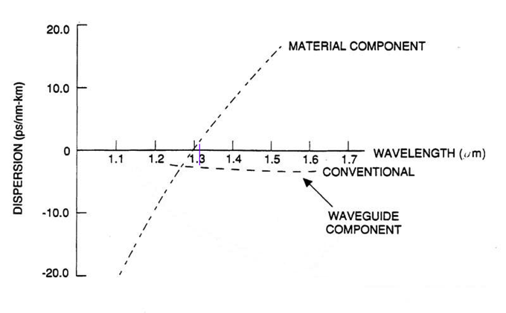
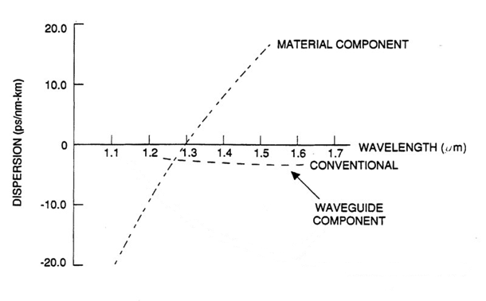
Zero-Dispersion Wavelength
Most SM fibers (SLS, SLX, SLA, and SLB) have zero dispersion point at 1310 nm
Typical value for SLX and SLA fibers 0.088 ps/nm²-km

Slide 9
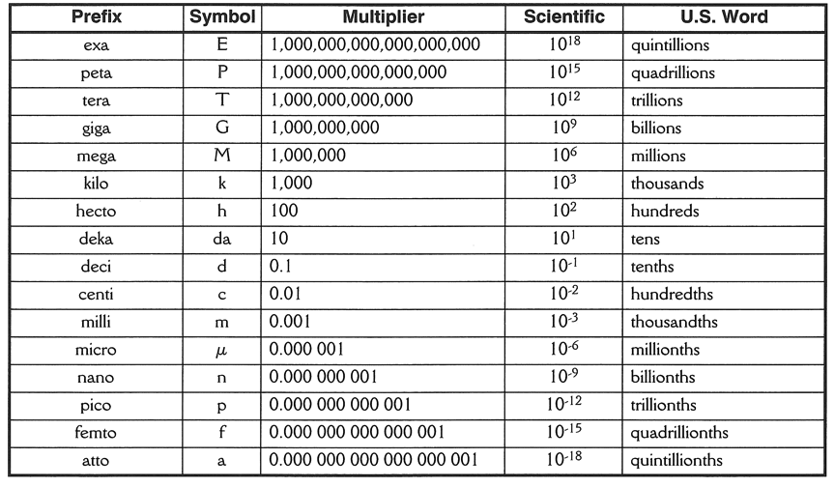
Numbers, Large and Small

Slide 10
Numbers Fun Facts
Optical fibers are measured in metric units
Nanometers and microns (1300 nm = 1.3 microns)
Microns and millimeters (900 microns – 0.9 mm)
Cable parameters may be in English or metric units
Feet vs. meters has forever been a source of errors in fiber optics – don’t let it happen to you!
Tensile loading may be quoted in lbs-f or Newtons
Jacket thickness is often measured in mils

Slide 11
Attenuation (or Power Loss)
Logarithmic decibel ratio of optical power output to power input in a fiber optic system
Input Power (dBm)
P1
Output Power (dBm)
P2
Optical Loss = P1-P2 (dB)
Note: dBm is the actual power level represented in
milliwatts
dB is the difference between the powers

Slide 12
Why use Decibels?
A very large range of numbers can be represented by a convenient number
Clearly visualize huge changes of some quantity
The overall decibel loss of a multi-component system can be calculated simply by summing the decibel loss of the individual components
Fiber and connector losses simply add together
The human perception of the intensity of sound or light is more nearly proportional to the logarithm of intensity than to the intensity itself

Slide 13
How Much Optical Power is Lost?
dB | Power Out as a % of Power In | % of Power lost | Remarks
1 | 79% | 21% | -
2 | 63% | 37% | -
3 | 50% | 50% | 1/2 the Power
4 | 40% | 60% | -
5 | 32% | 68% | -
6 | 25% | 75% | 1/4 the Power
7 | 20% | 80% | 1/5 the Power
8 | 16% | 84% | 1/6 the Power
9 | 12% | 88% | 1/8 the Power
10 | 10% | 90% | 1/10 the Power
11 | 8% | 92% | 1/12 the Power
12 | 6.3% | 93.7% | 1/16 the Power
20 | 1% | 99% | 1/100 the Power
30 | 0.1% | 99.9% | 1/1,000 the Power
40 | 0.01% | 99.99% | 1/10,000 the Power
Every 3 dB, ½ the power is lost
Every 10 dB, 90% of the power is lost

Slide 14
Optical Fiber Attenuation Spectrum
5
4
3
2
1
0
Water Peak
Caused by water absorption (OH⁻)
1st
Window
2nd
Window
3rd
Window
Attenuation (dB/km)
Operating
“Bands”
O
E
S
C
L
U
Secondary
Water Peaks
700 800 900 1000 1100 1200 1300 1400 1500 1600 1700
Wavelength - λ (nm)
Notes:
Graphical Representation
Transmission optical fibers are designed to be used in the infrared region, over the wavelength range from about 700nm to 1700nm (0.7 um to 1.7 um).
All optical fibers have a distinct attenuation curve over this region, whereby attenuation is higher at lower (shorter) wavelengths, decreases significantly in the 1200 – 1600 nm range, and rises rapidly at wavelengths greater than 1700nm.
Due to these attenuation characteristics and the different types of optical light sources that were developed, different “windows” and “bands” of operating regions were established:
Windows:
1st Window 850nm region
2nd Window 1310nm region
3rd Window 1550nm region
Band Name Wavelength (nm)
O Original 1260–1360
E Extended 1360–1460
S Short 1460–1530
C Conventional 1530–1565
L Long 1565–1625
U Ultralong 1625–1675
Generally speaking, the lower (shorter) the wavelength, the cheaper the light source is. That is part of the reason why multimode fiber continues to be the most economical fiber for shorter reach premises applications.

Slide 15
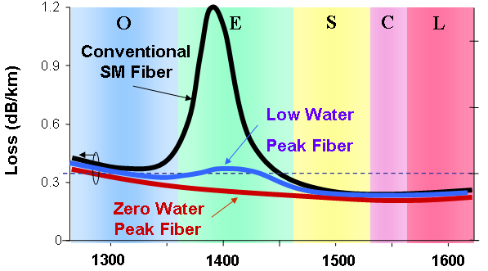
Low Water Peak vs. Zero Water Peak
Wavelength (nm)

Slide 16
What are those modes, Anyway?
Optical energy travelling along a fiber is contained by the core/cladding boundary
The geometry of the fiber, refractive index, and wavelength of light constrain the light energy to exist in certain discrete physical patterns called modes
The larger the core in wavelengths, the more modes which can exist
Single-mode fiber becomes dual-mode around ≤ 1260 nm

Slide 17
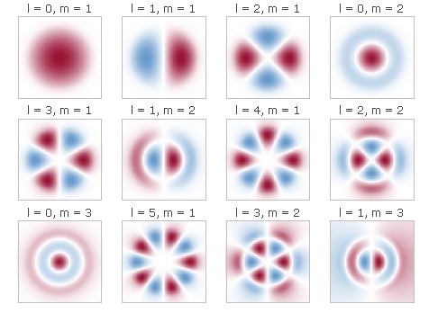
Just what are those modes, Anyway?
Finite number of EM field distributions in the FO core

Slide 18
Mode Field Diameter
For single-mode some light travels in the cladding (around 10+%)
Mode Field Diameter varies with wavelength
At 1310 nm 8.8 to 9.2 micron typical
At 1550 nm 10.2 to 10.5 micron typical

Slide 19
Analog vs. Digital
Analog means analogous, or a like representation of something else
Analog implies continuous change and infinite levels
Analog sound is a representation of vibration and varies continuously over a wide range
AM radio is analog because the strength of the radio signal varies just like the strength of a sound signal
Digital means having discrete levels and finite values
Our hands have 10 digits, not 3.14159265… digits
Morse Code is digital because it is a sequence of on or off timed pulses
Digital usually requires some form of computing power

Slide 20
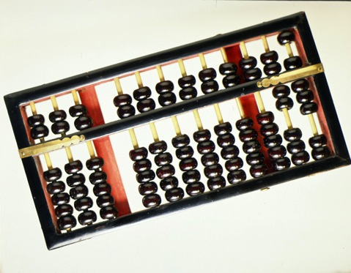
Early Digital Computer

Slide 21
Analog Computer

Slide 22
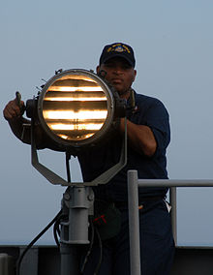
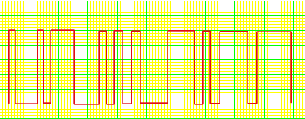
Light Signals may be Digitally Encoded
Example of light transmission of digital information

Slide 23
Digital vs. Analog
If the signal is just above the noise threshold, digital gives a more faithful reproduction of the input
Analog transmits the noise just like the signal
Digital is either on or off, so noise is rejected once the receiver makes the correct on/off decision
Digital encoding may feature error detection and correction algorithms
Digital requires some form of computing power
Processors needed for encoding and decoding the signal
The faster the processors and communications channel, the more information which can be transmitted

Slide 24
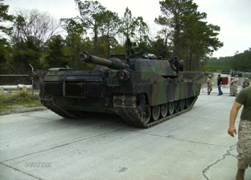
A Light Refresher on Fiber Optics Terminology
Questions?

