Slide 1
Rodent Resistant
Fiber Optic Cables

Slide 2
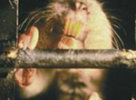
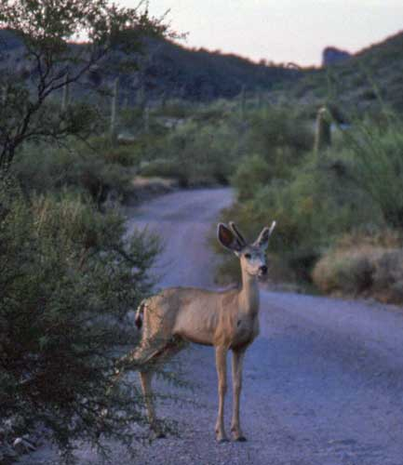
Introduction
Optical fiber cables can be exposed to a number of potential hazards in an indoor or outdoor environment.
Damage can occur in a relatively short period of time
The type and severity of damage depends upon several factors including species, type of installation/application, and the geographic location.
Rodent protection for optical fiber cables is generally based on making it difficult for the animal to gnaw into the cable core. However some rodent protection is based upon making the cable “blend in” with the surroundings.
The small diameter of fiber optic cables make them susceptible to gnawing. Diameters typically greater than 19mm (0.75 in) are generally less susceptible to gnawing.

Slide 3
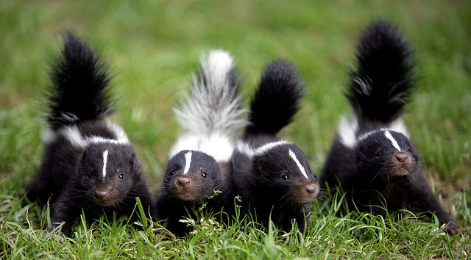
Competition
Competitors offer a variety of armoring for rodent protection
Corrugated Steel Tape (CST)
FRP
Steel Wire
Nylon Jacket
Chemical Repellents
Corning offers a dielectric armor in their Mic Cables, but make no statement about them being rodent resistant. They only mention crush resistance.
Some competitors state that their interlocked armor cables (ILA) are rated for direct burial and some even state that they are rodent resistant.
Most competitors in the industry do not recommend ILA for direct burial
Notes:
Inconsistence in the industry.

Slide 4
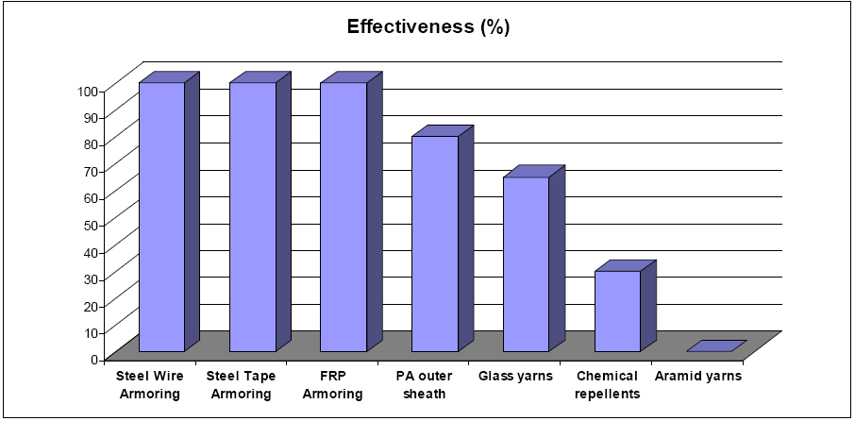
Competition
Belden lists a percent effective chart for various types of armoring.
There is no mention on how they determined the results.

Slide 5
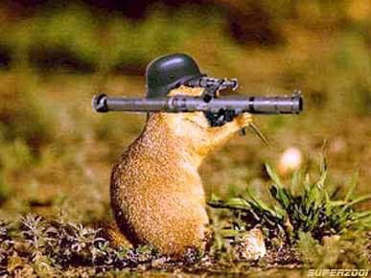
Armoring - OCC
CST
Excellent: Direct Burial, Aerial, Subterranean Tunnels
Caution: Conduit, Cable Tray
Not Recommended: Deployable
FRP
Excellent: Deployable, Subterranean Tunnels, Conduit, Cable Tray
Good: Aerial
Not Recommended: Direct Burial
Bitterant (non-toxic)
Excellent: Subterranean Tunnels, Deployable, Conduit, Cable Tray
Not Recommended: Aerial, Direct Burial
Braid
Excellent: Marine Applications
Poor: Deployable
Not Recommended: Direct Burial, Conduit, Subterranean Tunnels, Aerial, Cable Tray
ILA
Not Recommended: Any Rodent Protection

Slide 6
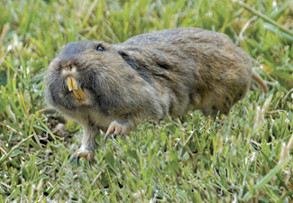
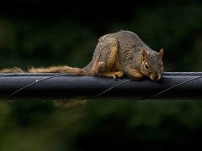
Know Your Threat!
Most important thing to understand is what will be the threat to the cable.
Once you know what the threat is, the correct armoring can be applied.
Some armoring works great for certain applications, but some armoring may attract mammals.
- Example: Bitterant – May attract Squirrels, but will deter rats/mice
Some applications may only require a color change
Some examples of threats OCC has came across: Rats, Gophers, Groundhogs, Deer, Monkeys, Termites, Jackals, Rabbits, Dingo’s, Goats, Oryx’s, Possums, Blue Crabs, Marmots, Snowshoe Hares, and Installers…

Slide 7
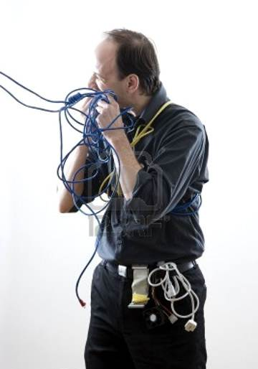
Know Your Threat!
Some installers will do anything to make it look like a cable or rodent issue and not an install issue.
Notes:
Some installers will do anything to make it look like a cable issue and not an install issue.

Slide 8
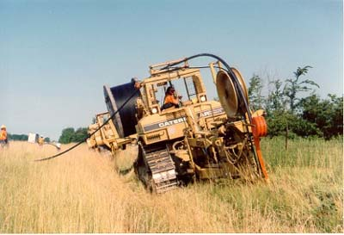
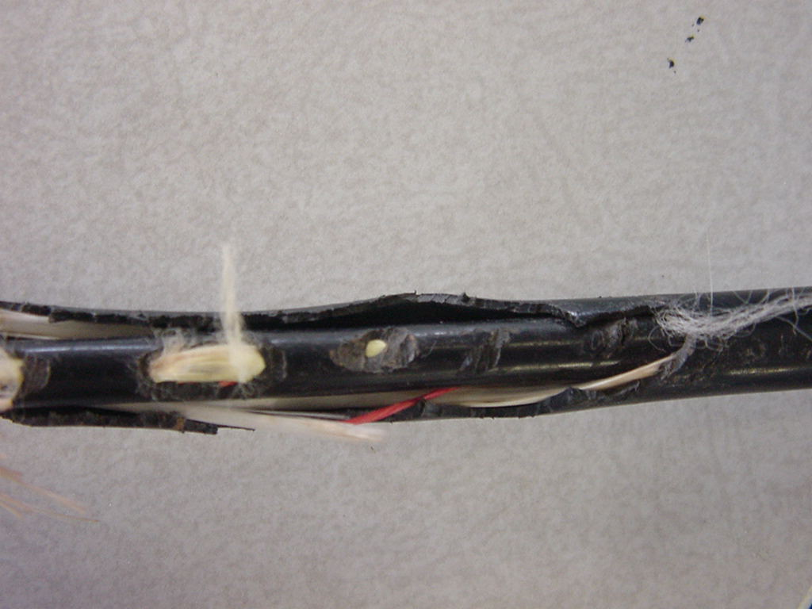
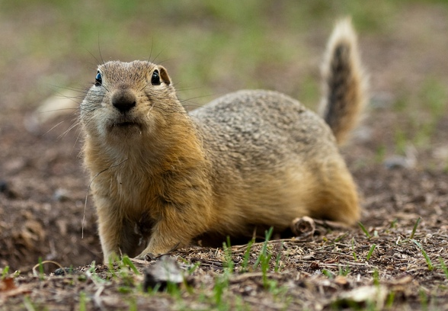
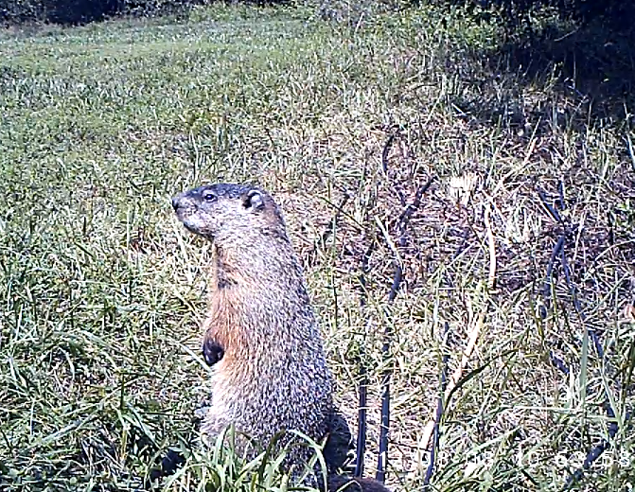
Direct Burial
Only Corrugated Steel Tape (CST) is the only armoring recommended for Direct Burial
Designed for use with burrowing and non-burrowing Rodents
Non-CST cables do not offer adequate protection from burrowing rodents
FRP subjected to Gophers
Gopher
Ground Hog

Slide 9
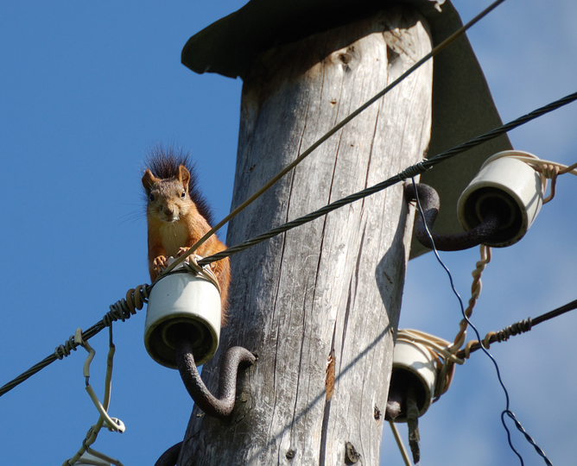
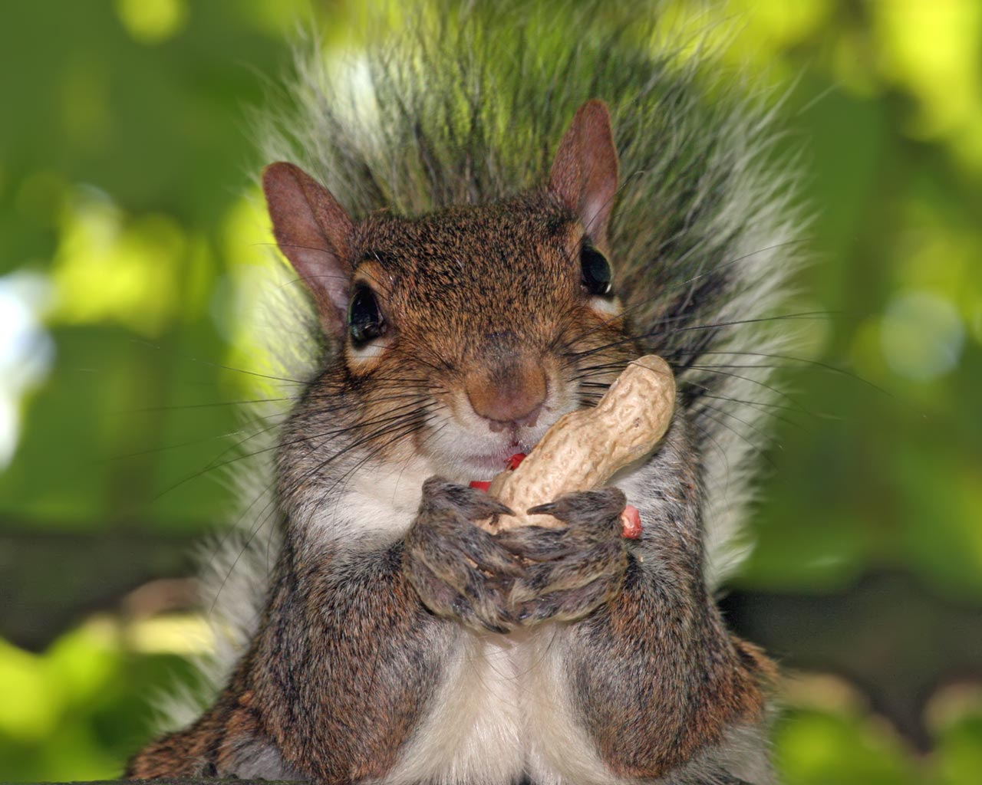
Aerial
Squirrels are typically the culprit
Lashing CST provides best protection
Requires Grounding
Lashing FRP can be an alternative
Bitterant not really recommended for Squirrel resistance
Squirrels equate bitter taste to bitter tasting nutshell. They will eat through the bitterant jacket hoping to find a nut inside.

Slide 10
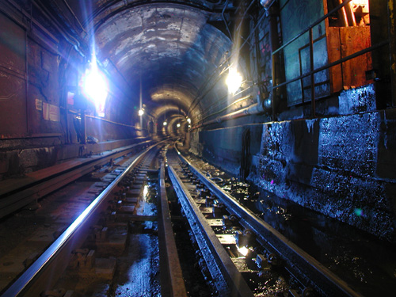
Subterranean Tunnels
Rats and Mice are typically found in these locations
FRP is used to deter rats and mice
Bitterant can be added for further rat and mice resistance
LSZH may be required
DX series FRP LSZH Riser from 2-12 Fibers, 18-48 fibers with just LSZH
DX series CST LSZH Riser from 2-12 Fibers, 18-48 fibers with just LSZH
If Burrowing Rodents are present, CST is required

Slide 11
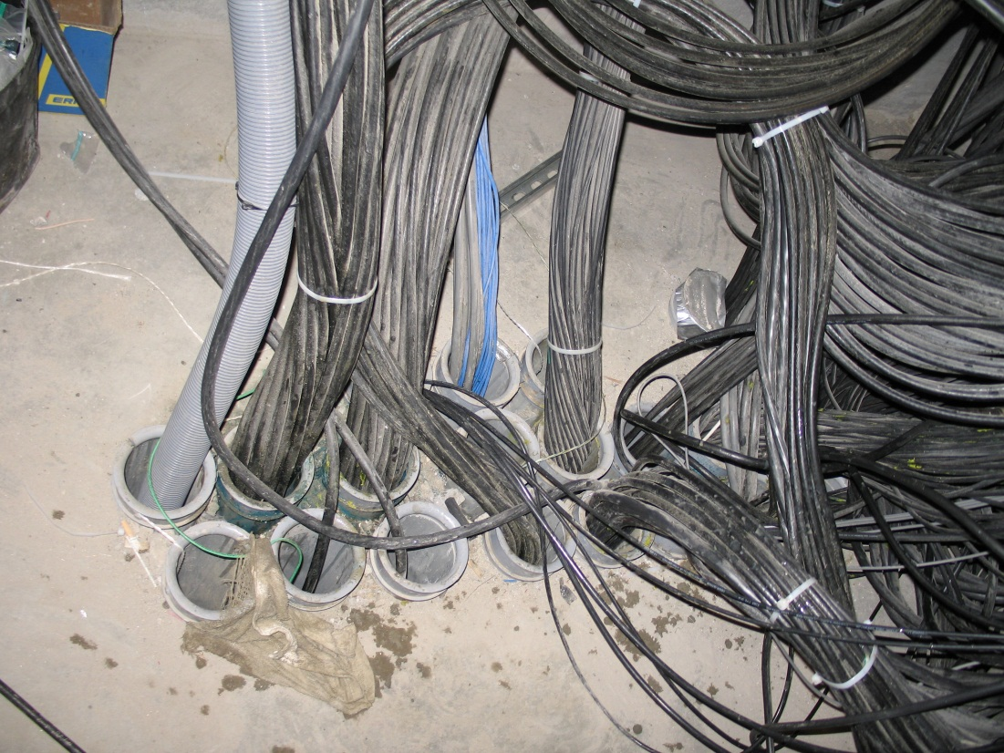
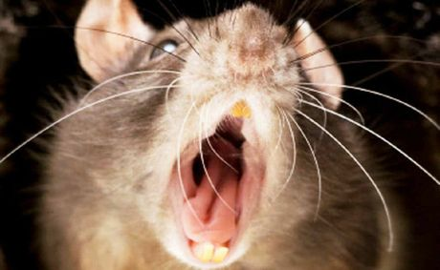
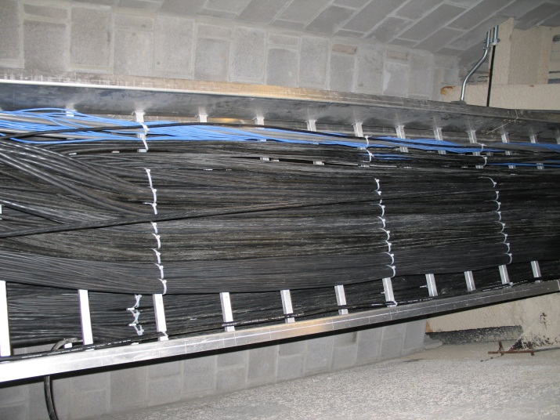
Conduit/Cable Tray
FRP
Rats and Mice are typically found in these locations
FRP is used to deter rats and mice
Bitterant can be added for further rat and mice resistance
DX Series 2-144 fibers with FRP and Riser Rating
CST
CST Not typically recommended but can be used
Increases Diameter (up to 177%)
Increases Weight (up to 370%)
Increases Tensile Loads
Increases Minimum Bend Radius (up to 154%)
Decreases the number of cables that can be installed in a single conduit (fill ratio)
Decreases crush resistance
Attention to detail when attaching a pulling grip

Slide 12
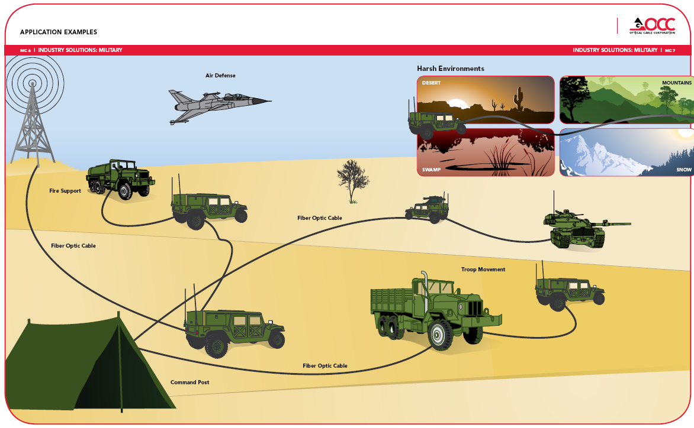
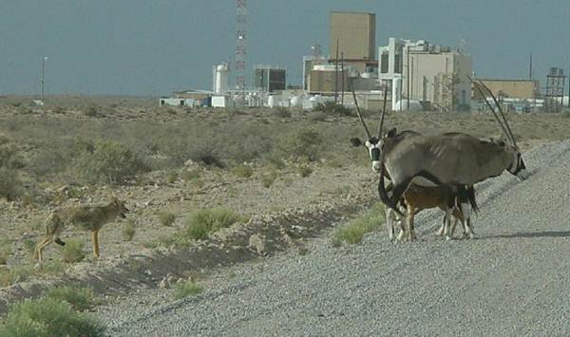
Deployable
Dielectric
Wide range of threats in this environment
FRP gives maximum protection for deployable
surface rodent protection
Low Luster V jacket with appropriate color
Designed to make cable “blend in” with surroundings (prevent deployable cable appearing like a snake)
Coyotes, Jackals, Deer, and other large mammals
Bitterant may be added for further resistance
Metallic
CST and ILA are never recommended
Metallic Braid not generally recommended
Braid used for Marine Grade applications
Defeats purpose of using Fiber Optic Cable
Heavy
Large Diameter
Stiff
Metallic
If you have a customer that mandates metallic Braid or CST, contact OCC Engineering

Slide 13
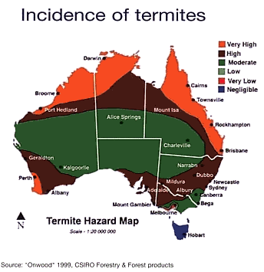
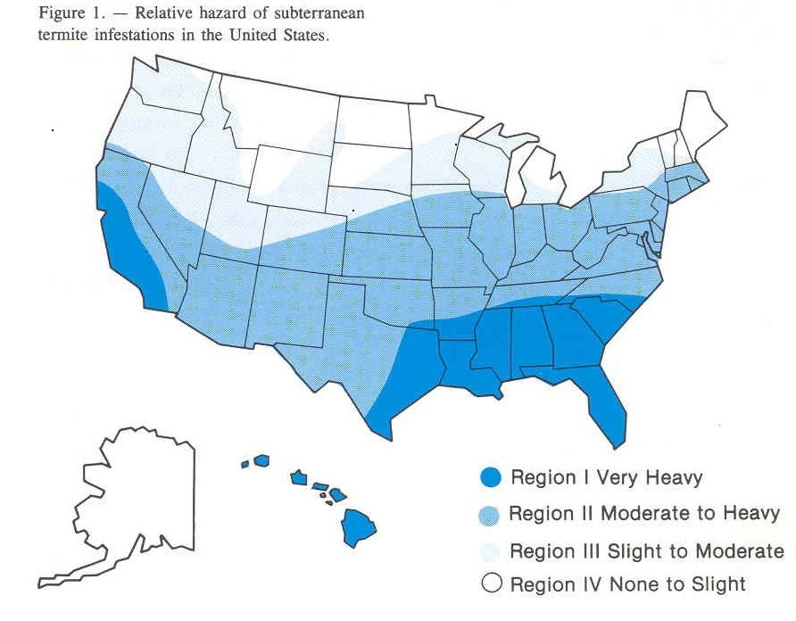
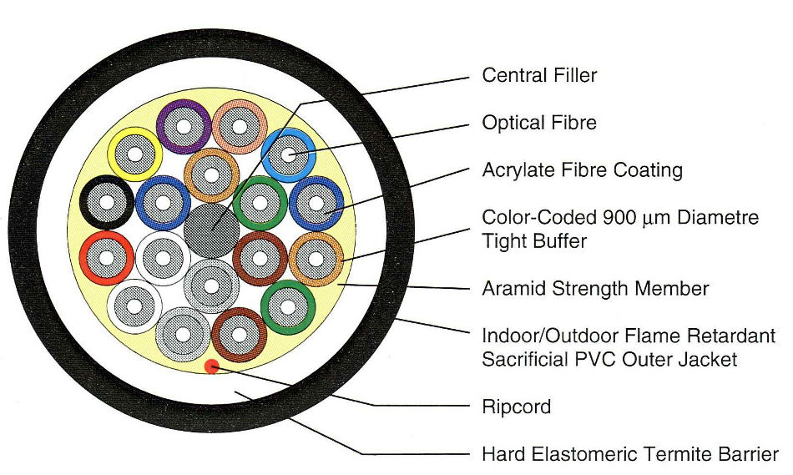
Termite Resistance
Specific threat for selective locations
Termites can be very aggressive in attacking an outer jacket
DX Series cable
Hard Elastomer inner jacket
PVC Outer Sacrificial Jacket

Slide 14
Field Trials – Rodent Resistance
Nobody in North America testing fiber optic cable rodent resistance with caged rodents
OCC conducting field trial. Currently on-going.
All cables located at OCC in Roanoke, VA
Multiple cable types laid in parallel next to pathway for burrowing rodents
 | Part Number | Description | Jacket Color | Diameter (mm) | Bitterant
1 | OC-0002818 | D-006V, bitterant, Sand Beige | Beige | 6 | Yes
2 | OC-0001138 | D-012V, bitterant, Sand Beige, FRP | Beige | 11 | Yes
3 | D-040VWST9KA-M022 | D-040V,Bitterant | Black | 10.3 | Yes
4 | DX012ZWLS9KAB2-MABS | DX012Z, Bronze Braid, Z outer jacket | Black | 11.5 | No
5 | DX012DALT9KAF4 | DX012D, FRP, D outer jacket | Black | 11.5 | No
6 | DX012DWLS9KAA2 | DX012, CST, A outer jacket | Black | 13.4 | No
7 | Braided TBFUN Prototype | TBFUN with R inner jacket, Stainless Steel Braid, V outer jacket | Black | 7.1 | No
8 | GMTTAZ02 | Beldon Tactical Cable | Black | 5.48 | ?
9 | B-002VSLS95KM | B-002V Standard Mil Tact | Black | 6.5 | No

Slide 15
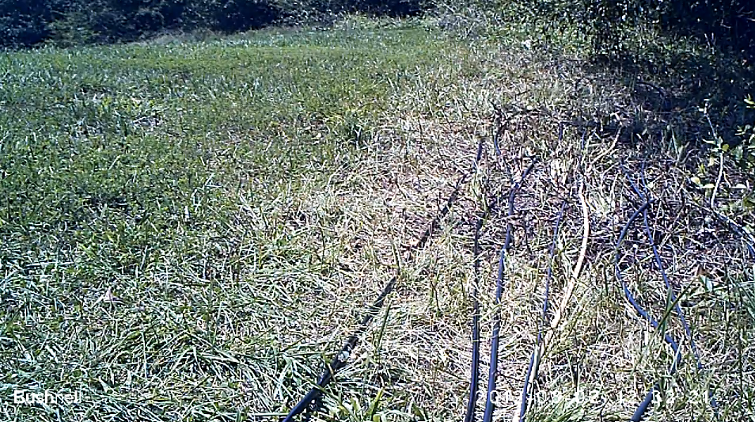
Field Trials – Rodent Resistance
Currently

Slide 16
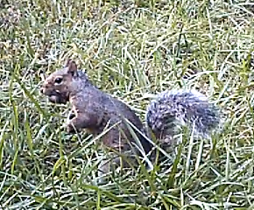
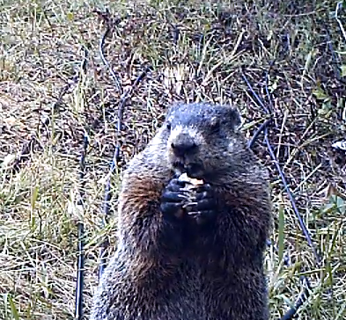
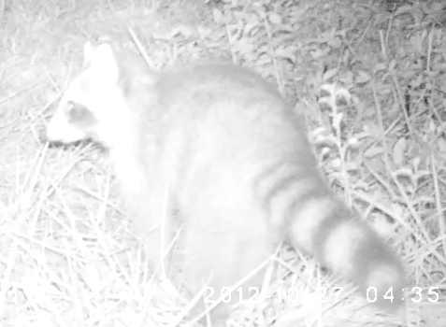
Field Trials – Critters of the day and night

Slide 17
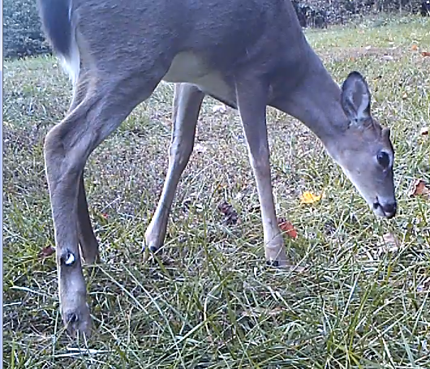
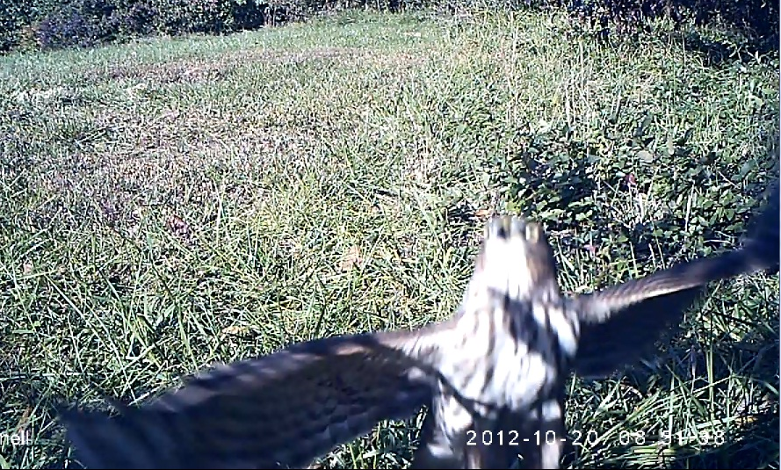
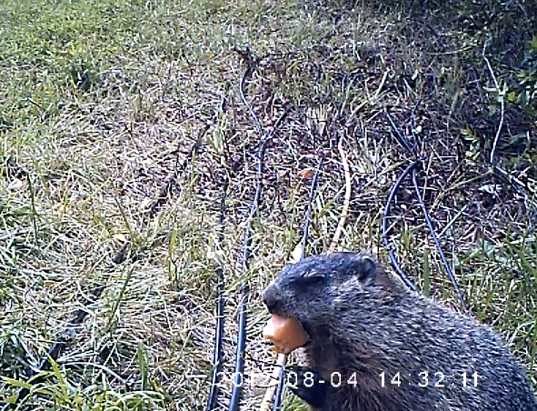
Field Trials – Critters of the day and night

Slide 18
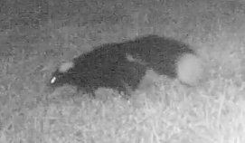
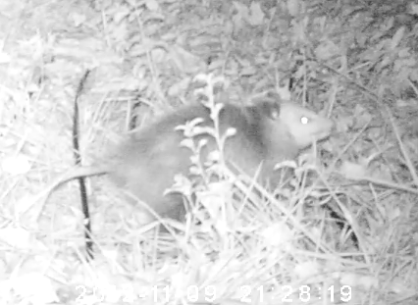
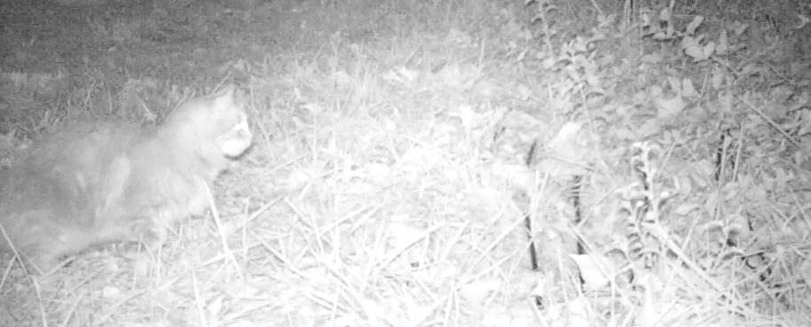
Field Trials – Critters of the day and night

Slide 19
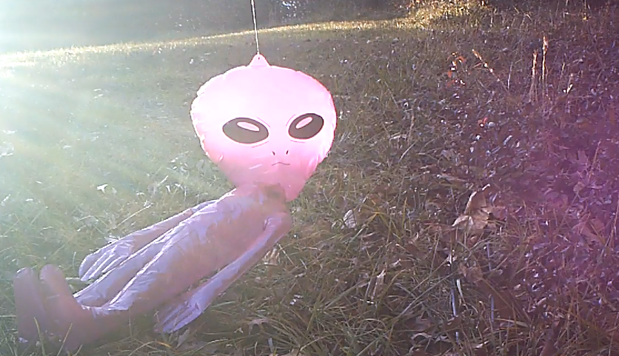
Field Trials – Critters of the day and night

Slide 20
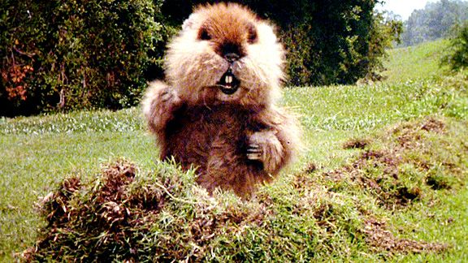
Questions

